Slide 1
Kuali TEM Module
CERTIFYING AND APPROVING YOUR TRAVEL DOCUMENT

Slide 2
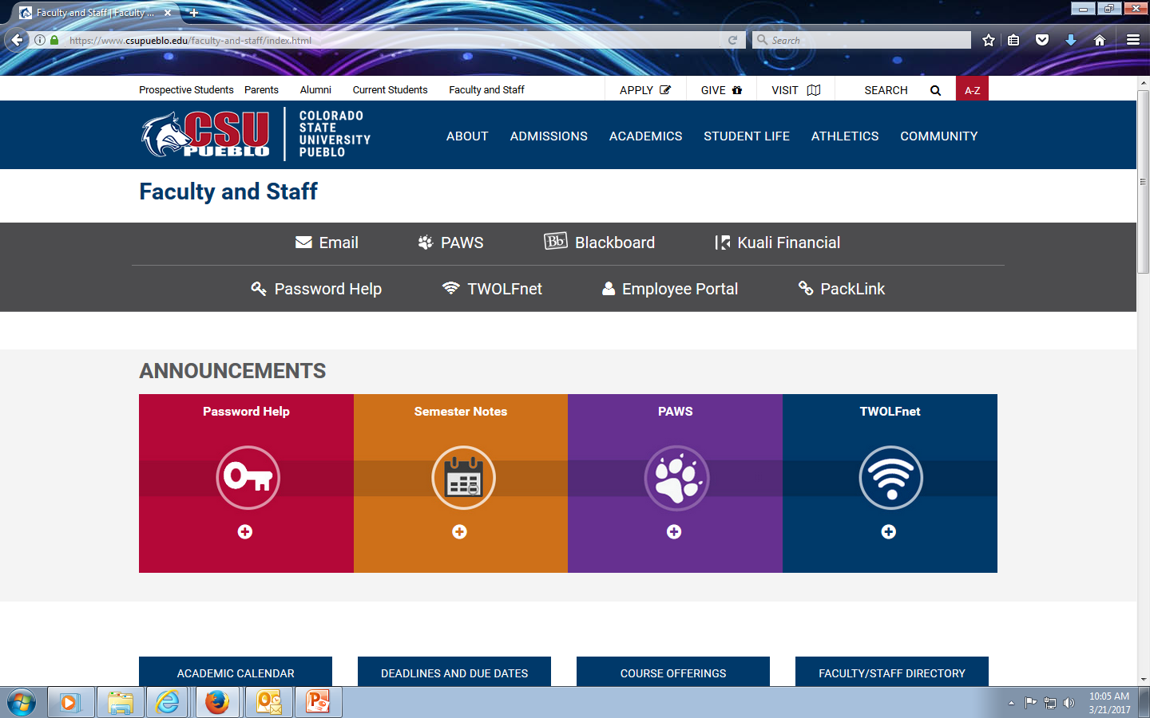
How does Traveler approve?
*Go to University website
*Select Faculty and Staff link *Then click the Kuali Financial link

Slide 3
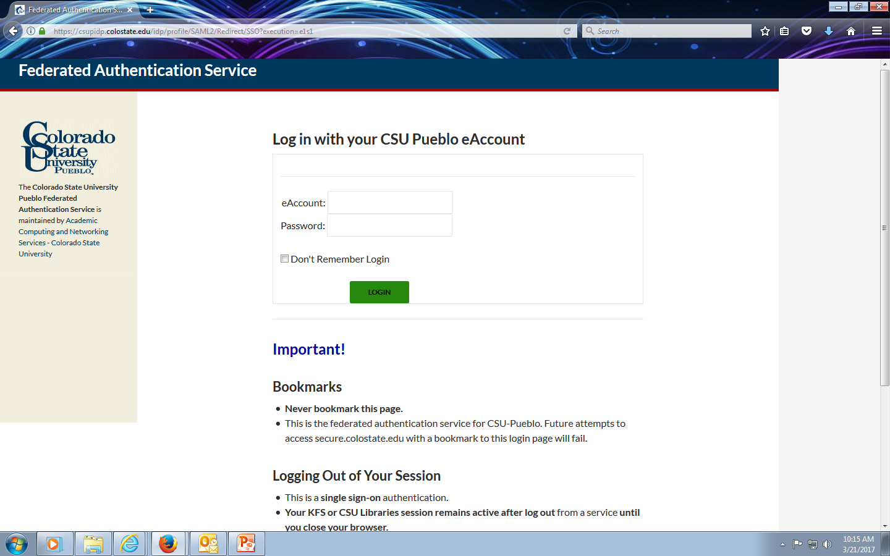
Log in with same username and password you use to get on to computer

Slide 4
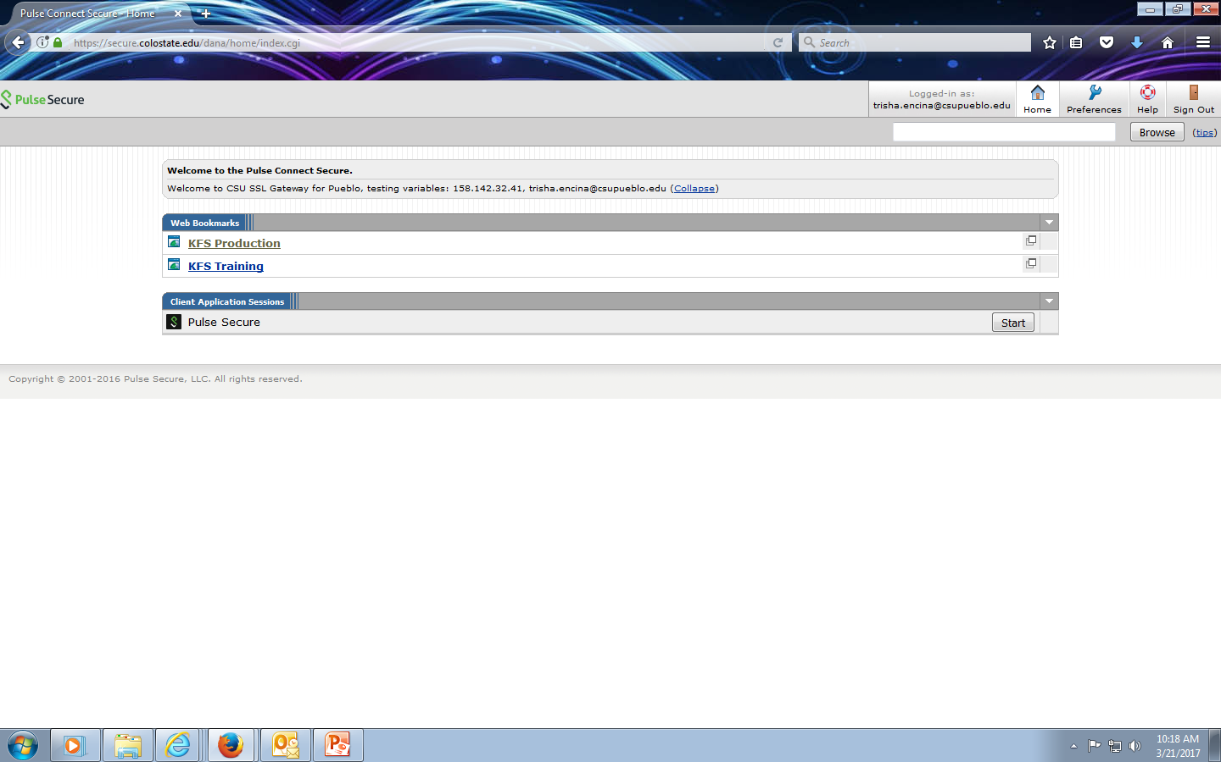
Select KFS Production link

Slide 5
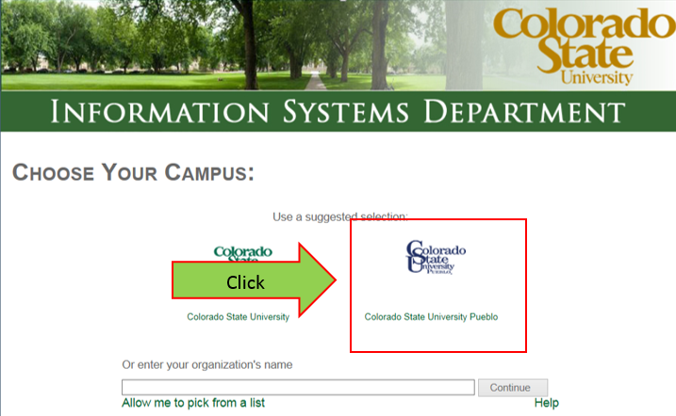
After logging in, select “Colorado State University Pueblo” logo

Slide 6
Log in again!
Enter existing sign in info again

Slide 7
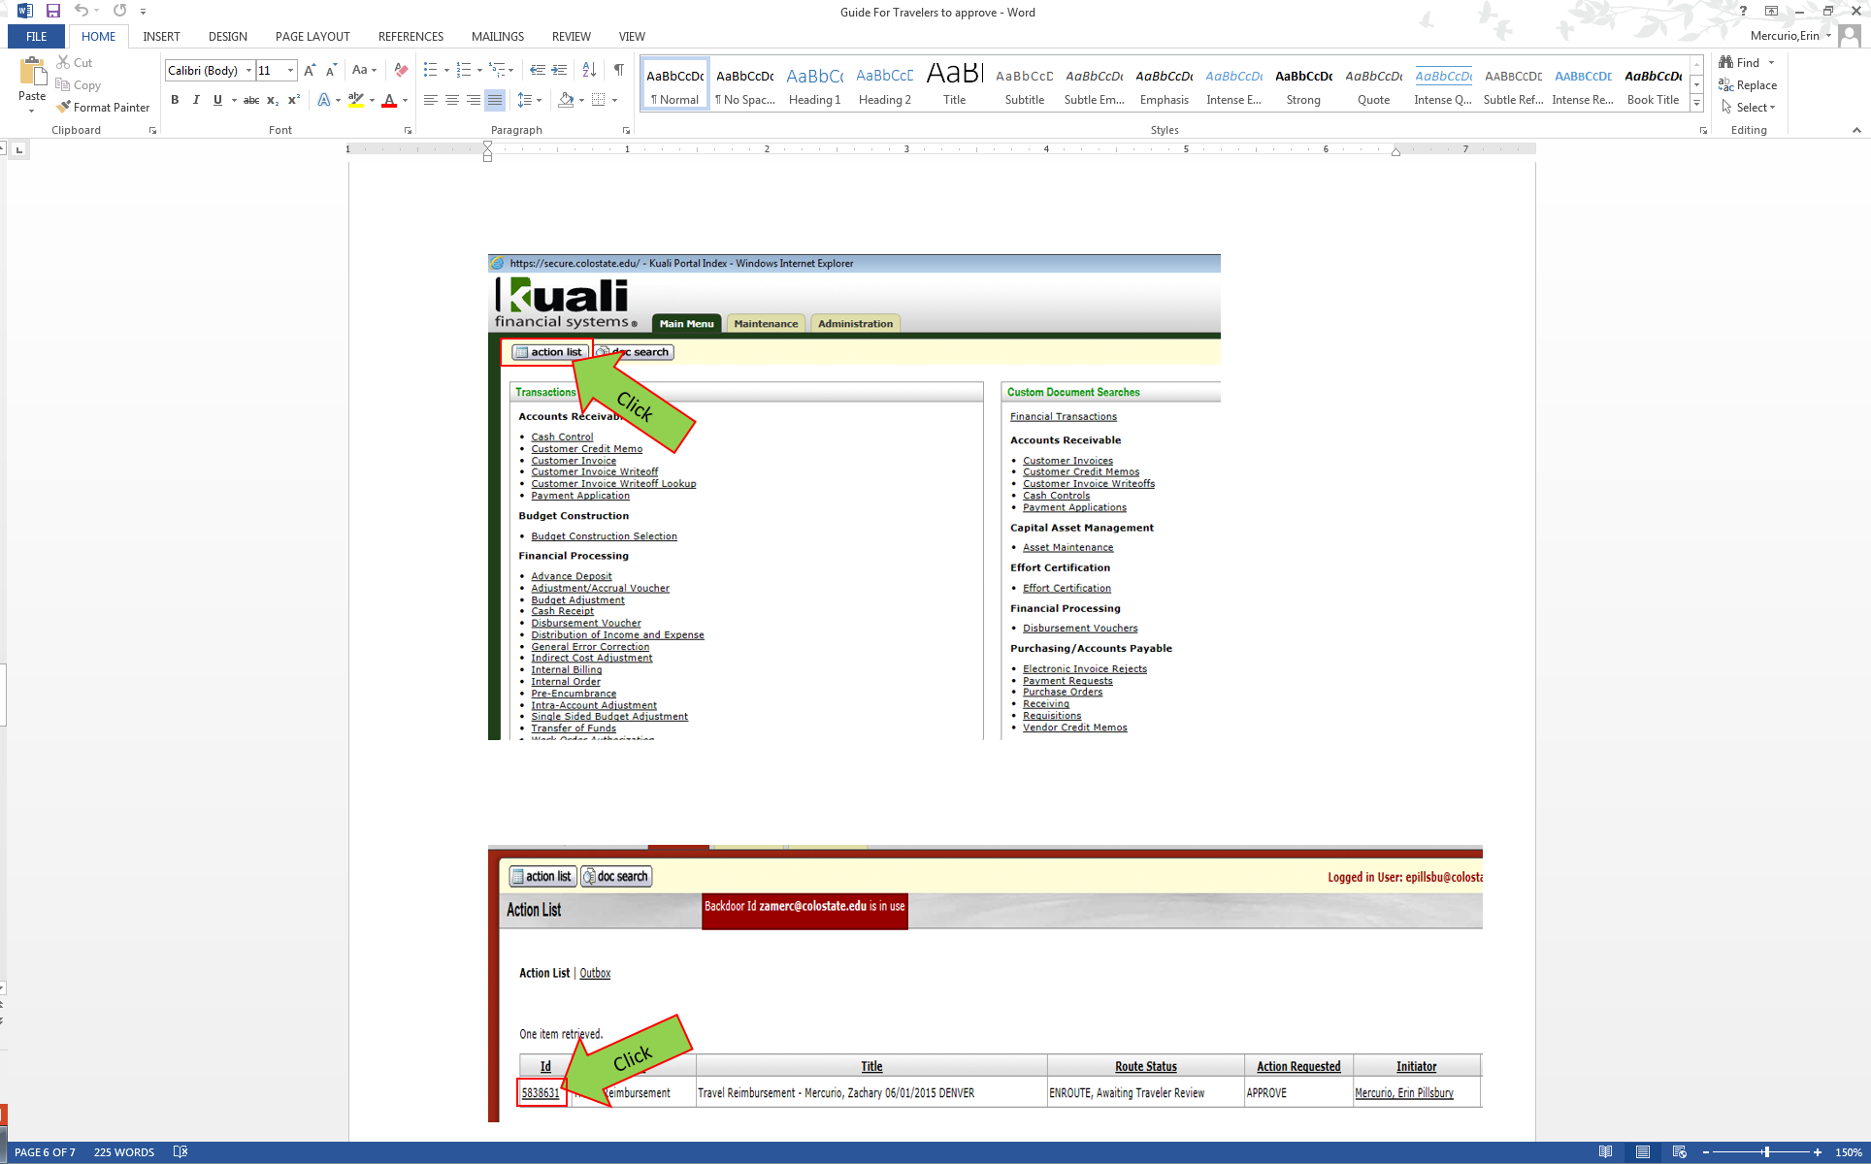
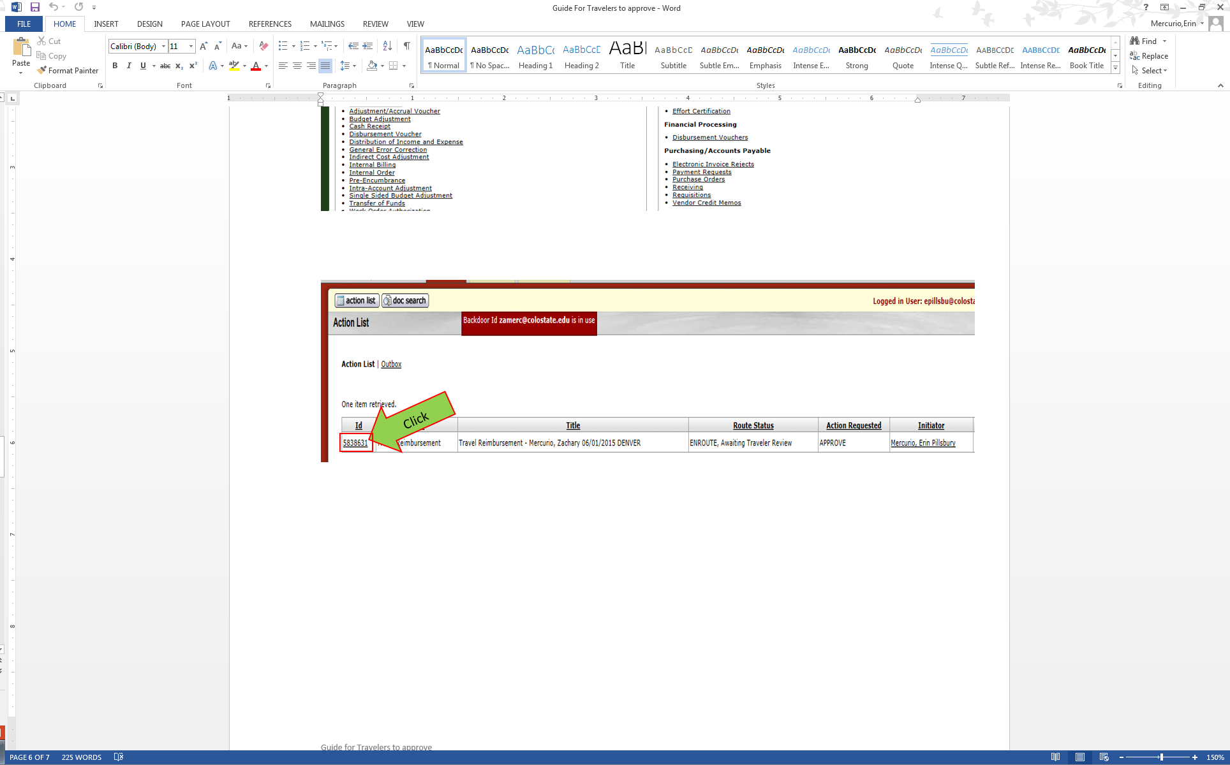
Click on action list
Then click on document number

Slide 8
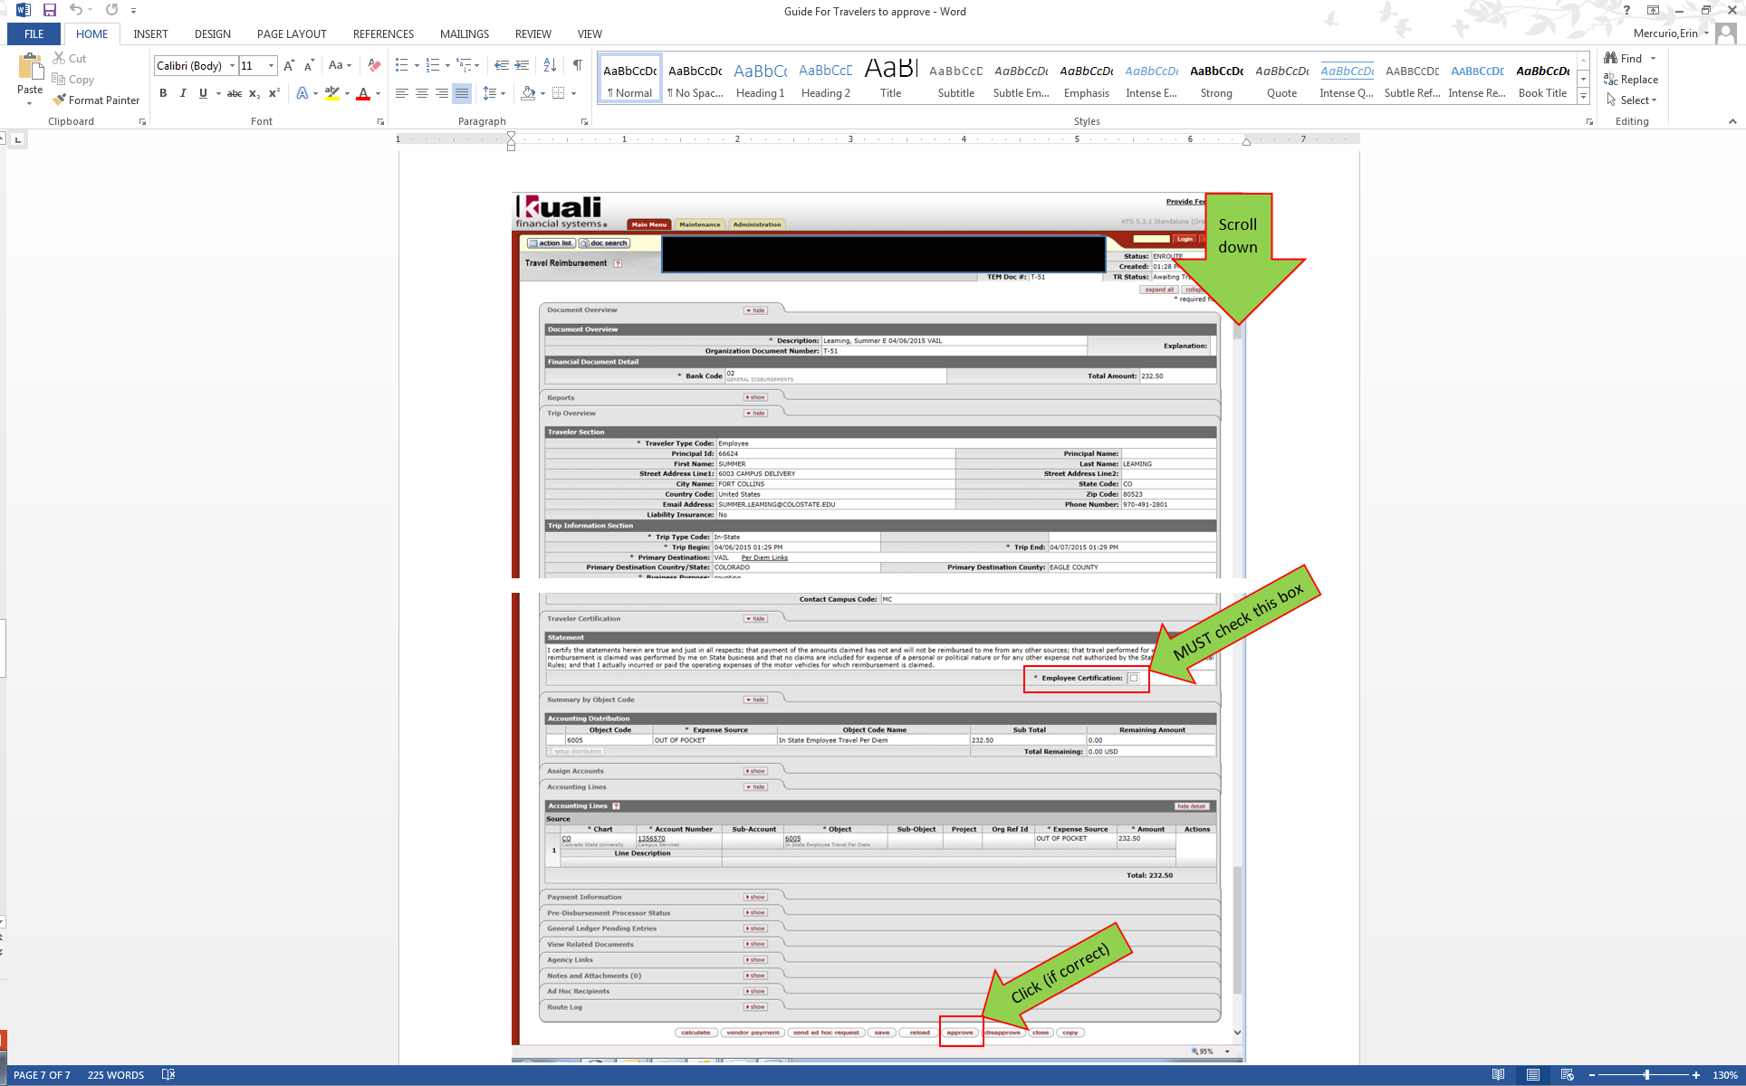

Slide 9
You are finished!

