Slide 1
DARSweb
Office of the registrar

Slide 2
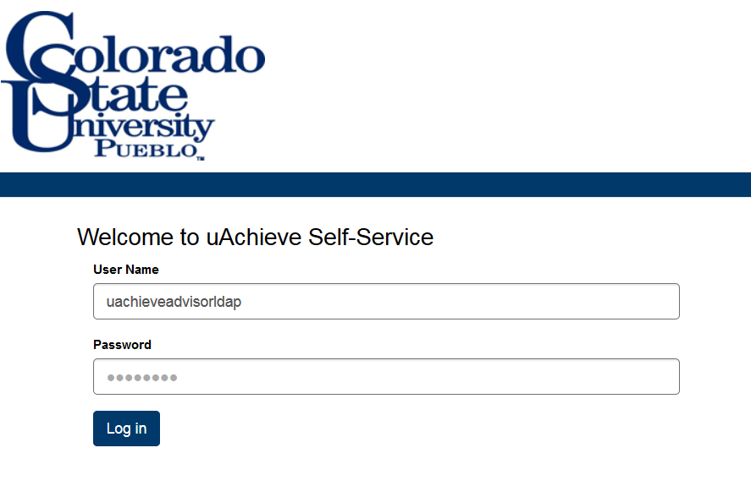
Welcome to the Darsweb homepage
Please Note--
Double verification is required, so please log in twice!
Password CANNOT contain the following characters:
< > “ & %
*You can reset your password via “Password Help” on under “Faculty and Staff” on the main website

Slide 3
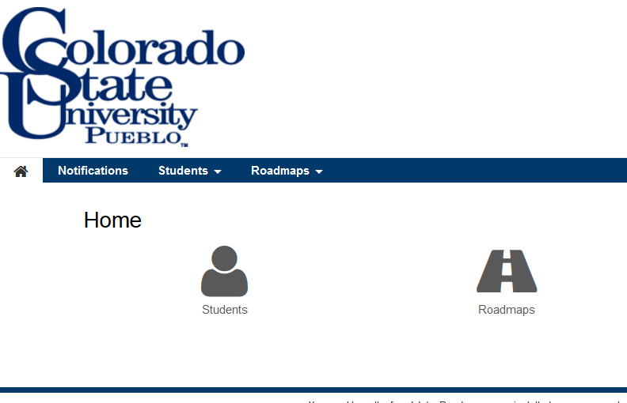
about
The items circled in blue are two ways to run a student’s DARS

Slide 4
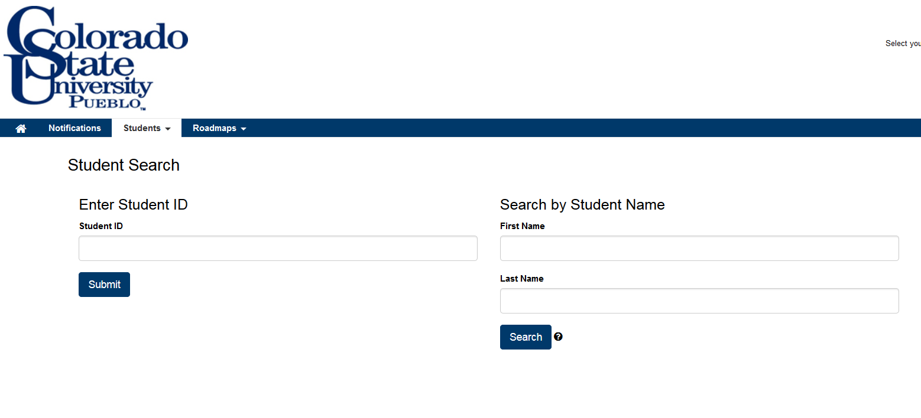
Two ways
You can look up a student by PID or by name
Click the button at the bottom of each selection to proceed
Type PID before proceeding!

Slide 5
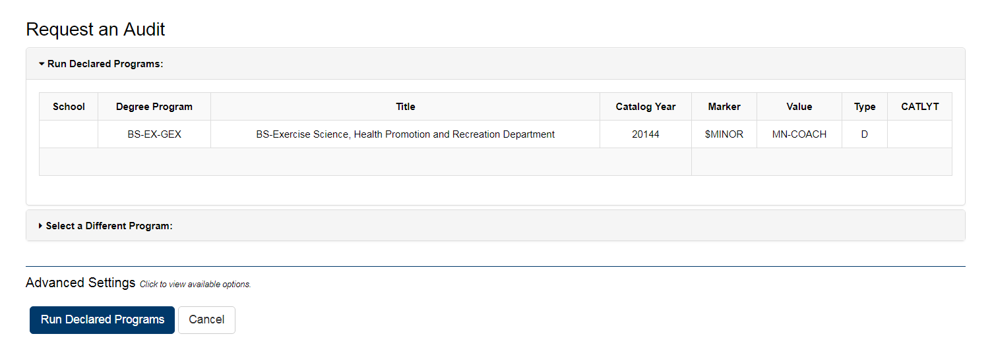
Student’s declared program
Click here to run the audit

Slide 6
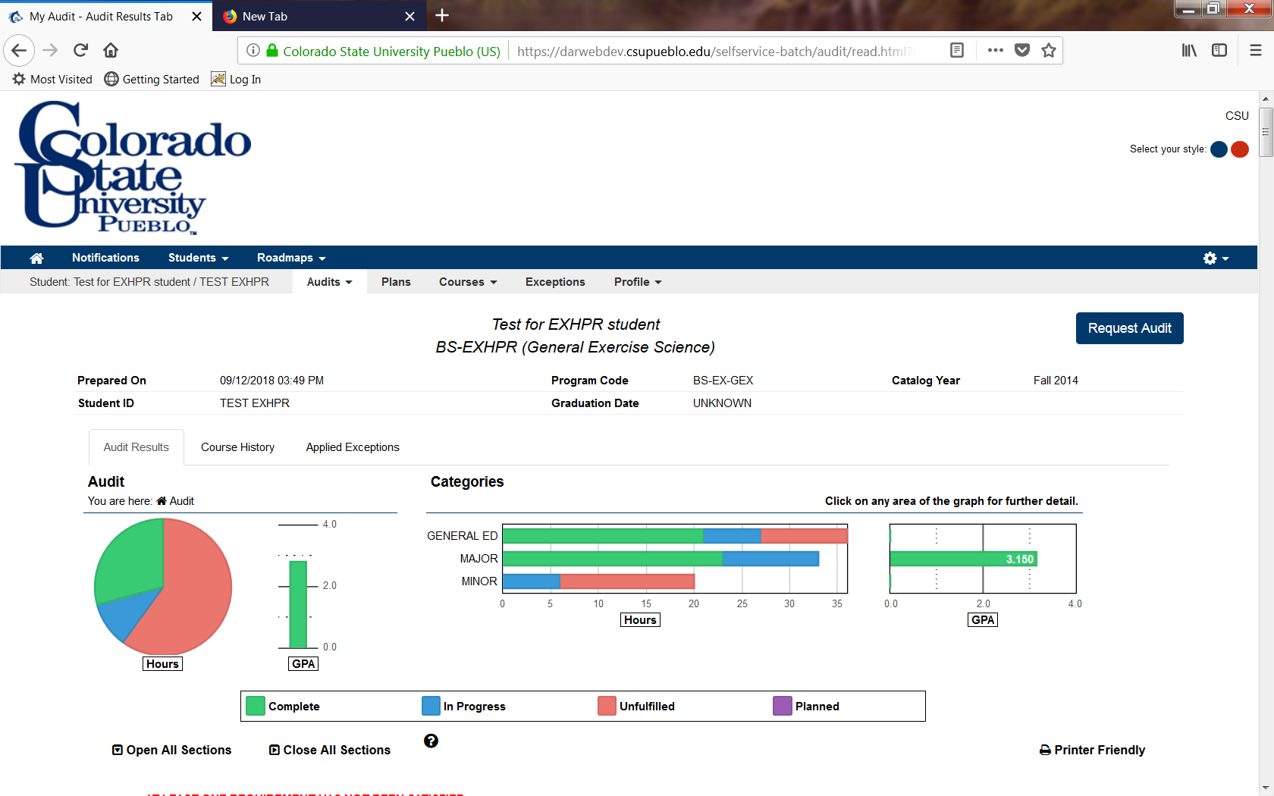

Whatever program shows here is the student’s declared program
Student name
Declared catalog year
New color legend

Slide 7
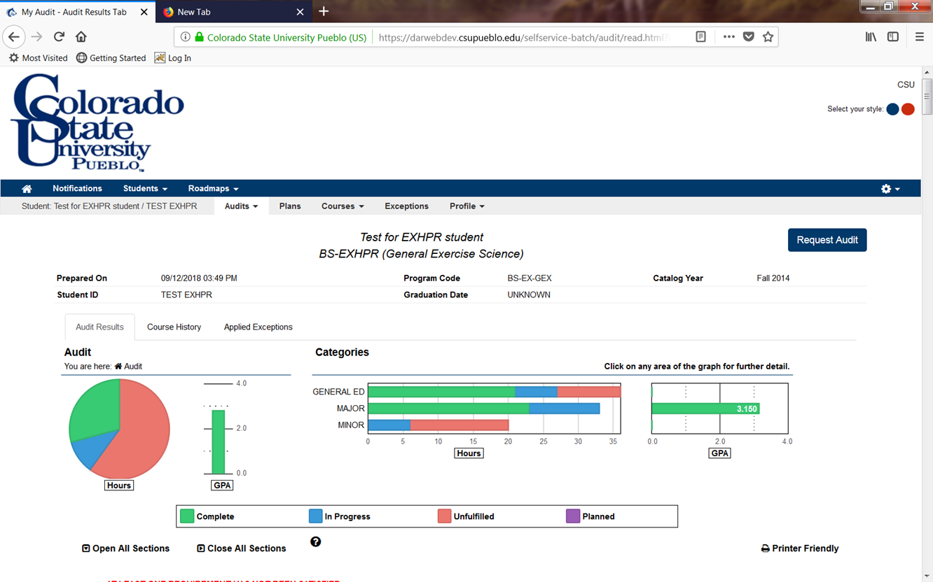
Click here to see all courses a student has taken. Including transfer and home!

Slide 8
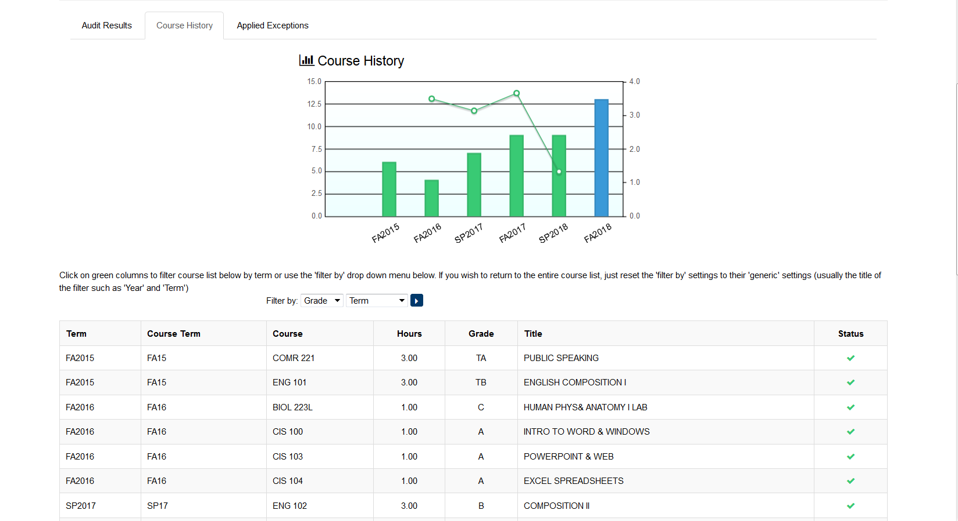
Student’s GPA
Hours completed
Term
Transfer course
Home course

Slide 9

Shows processed exceptions for students

Slide 10
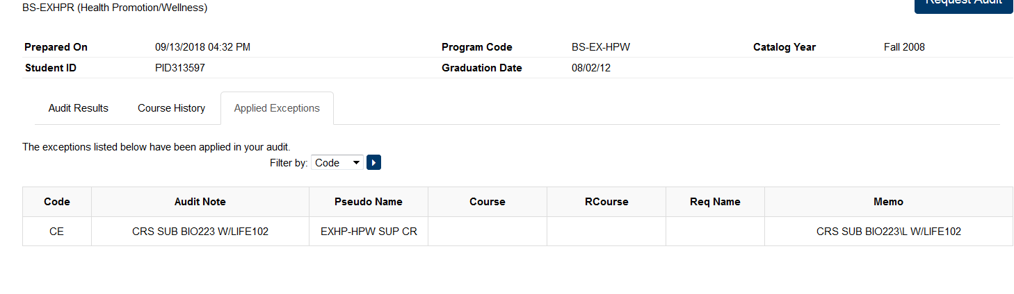
Processed exceptions applied to the audit are shown here

Slide 11
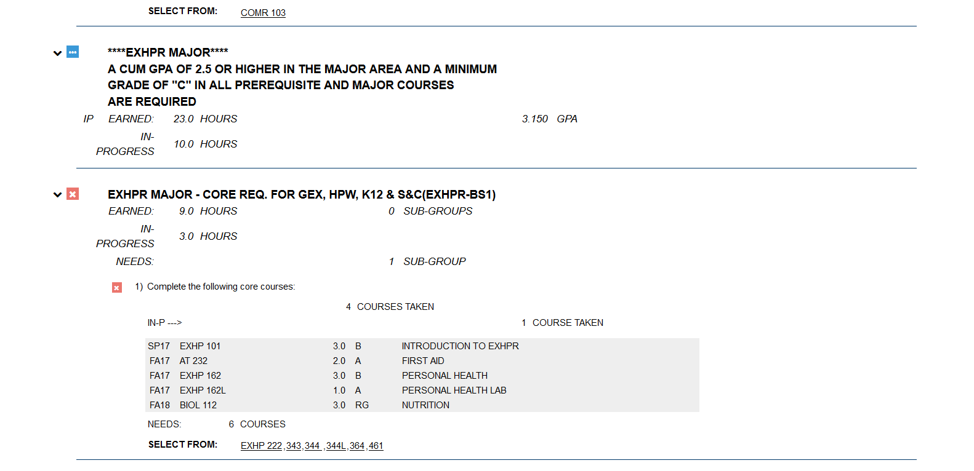

Blue box indicates IP (in progress) courses are currently fulfilling requirement
Red box indicates requirement not fulfilled
Shows required classes left to take

Slide 12

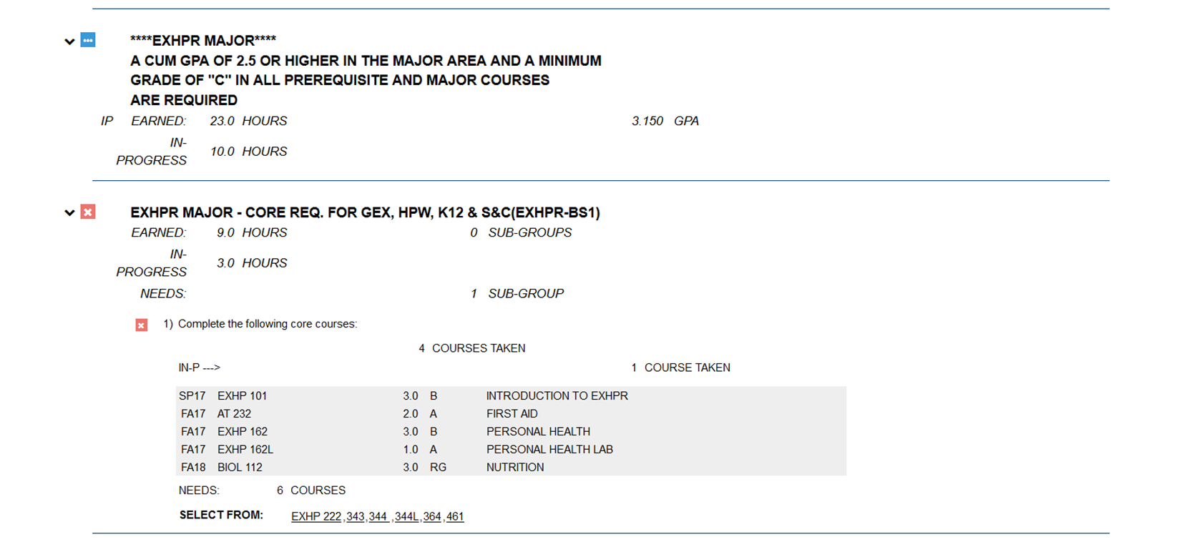
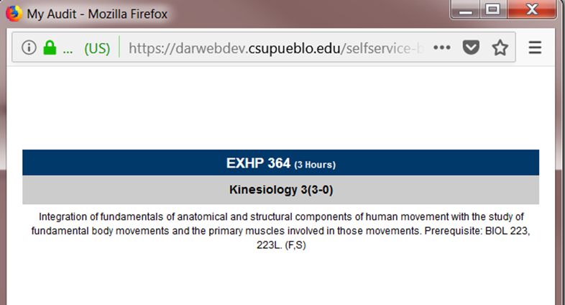

Slide 13
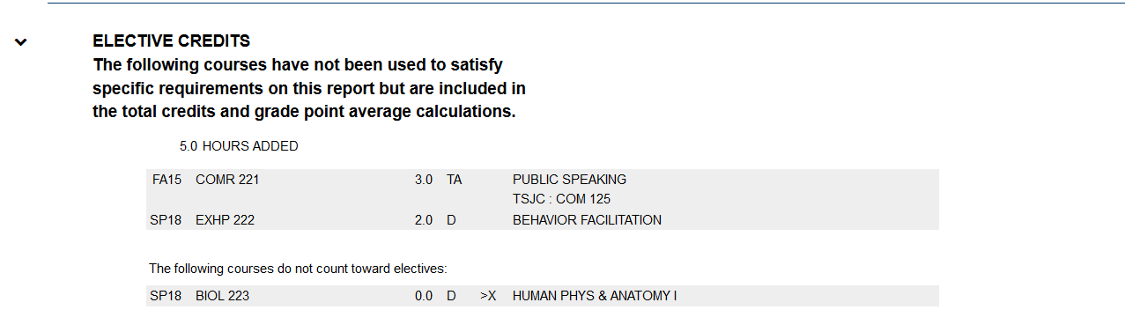
Elective credit

Slide 14
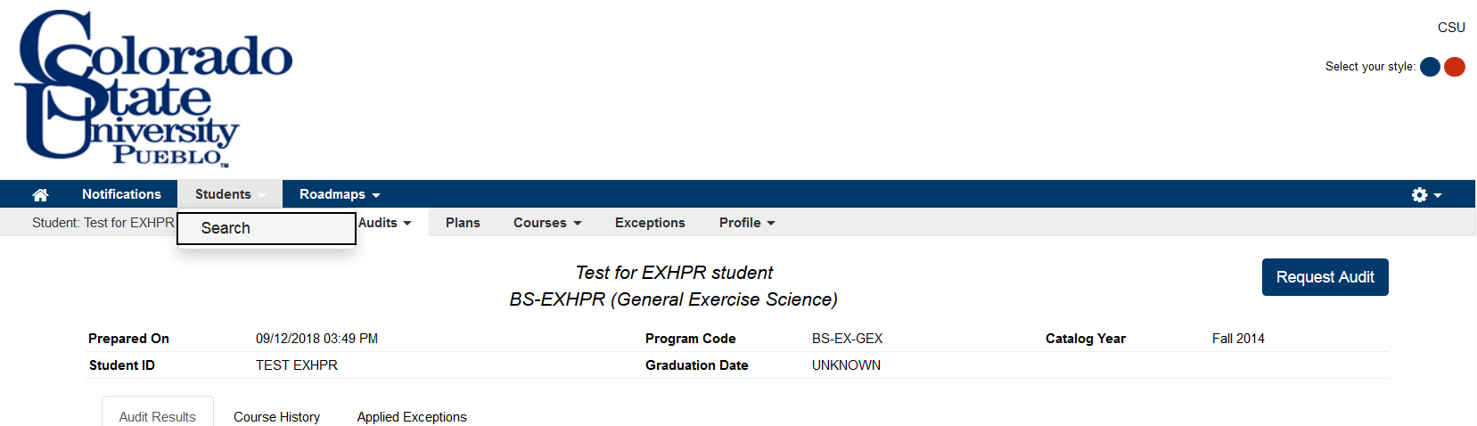
Use this pathway to leave the current student and create a new audit for a new student
Use this button to request another audit for the current student or run an alternate degree program

Slide 15
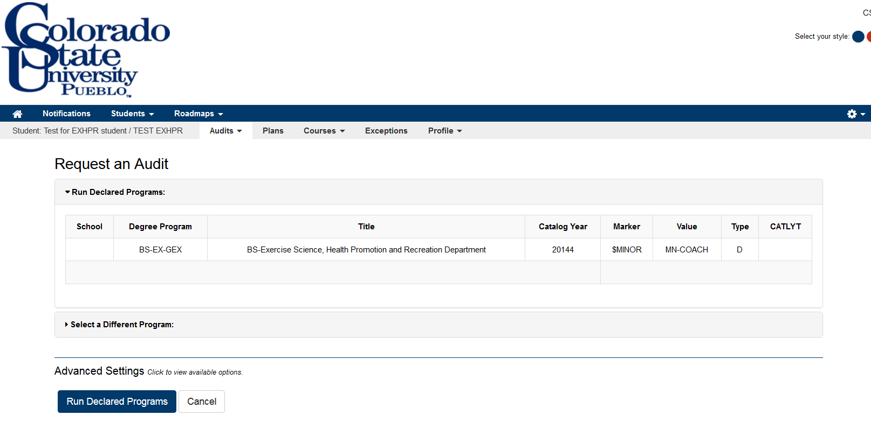
HOW TO RUN A FORMER “WHAT IF”
Pull up student’s audit
Click on run audit once On student’s profile
Click on the “select a different program”

Slide 16
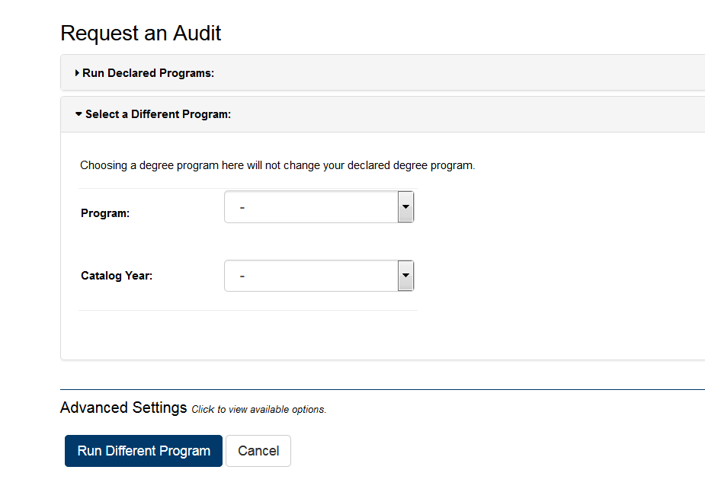


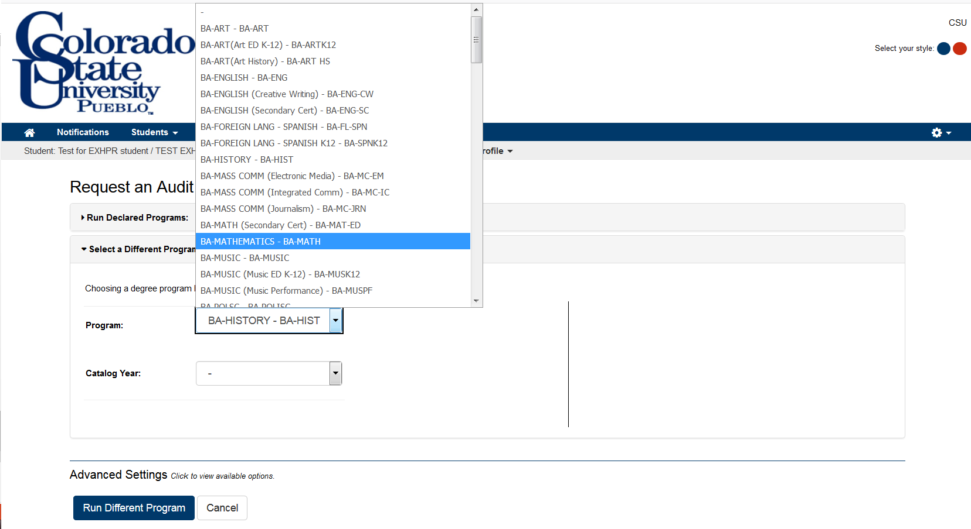
Use the drop down arrow to select
a different program or catalog

Slide 17
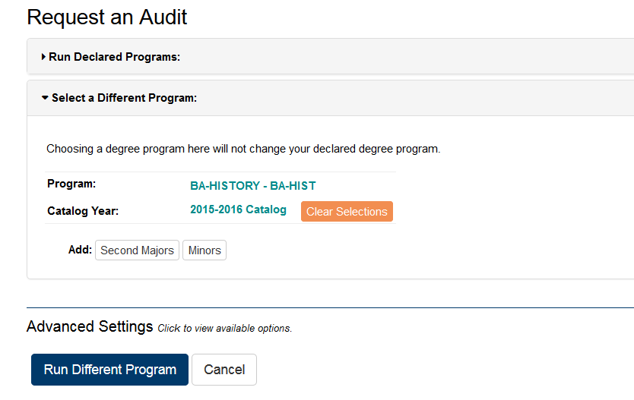
You can add 2nd majors and minors here
Once you have made your selection, please click “run” to proceed

Slide 18
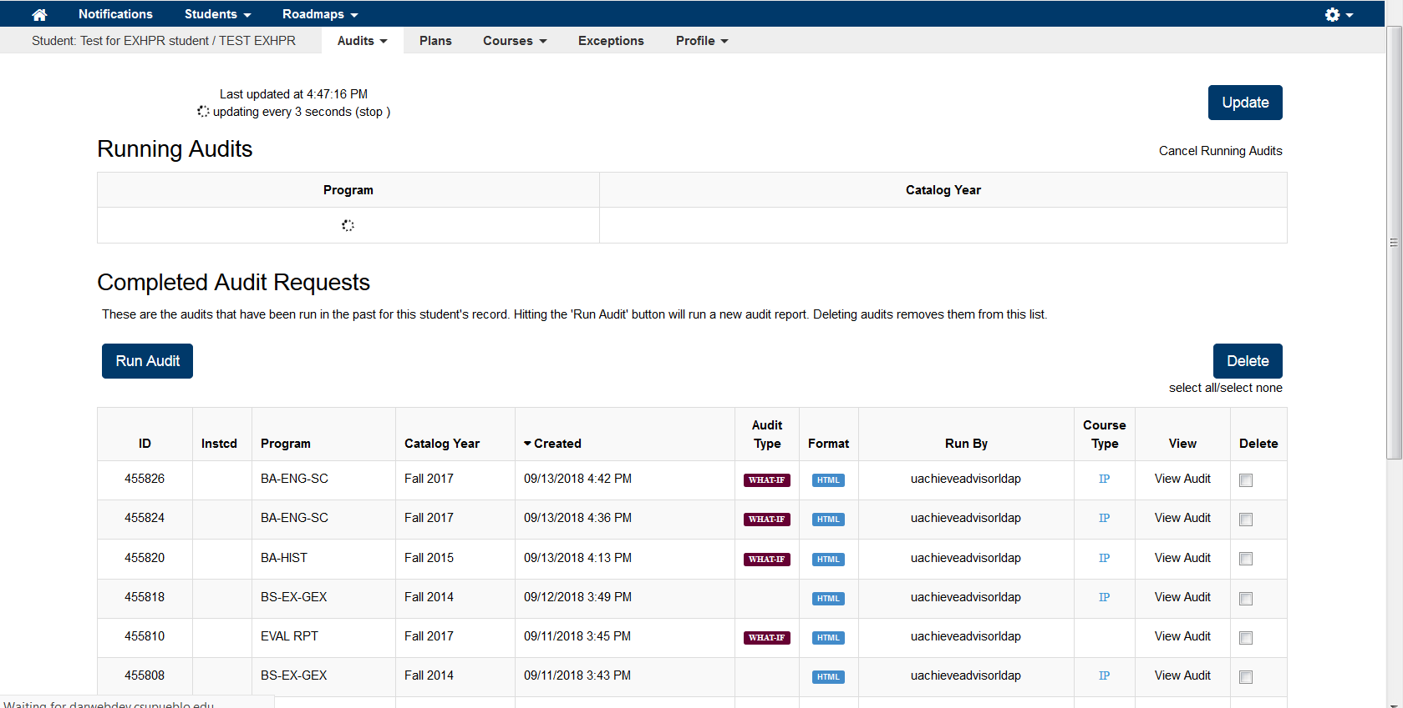

Indicates the audit is running
Click here to select an audit to view
Previous audits are shown here
Types of audits

Slide 19
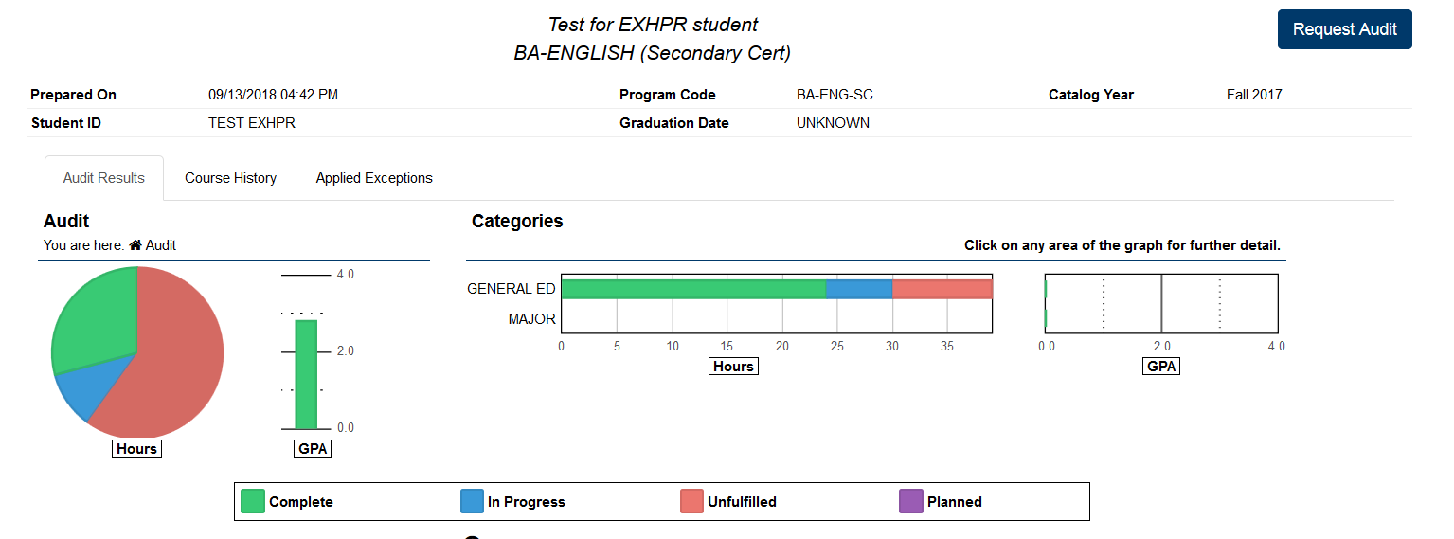
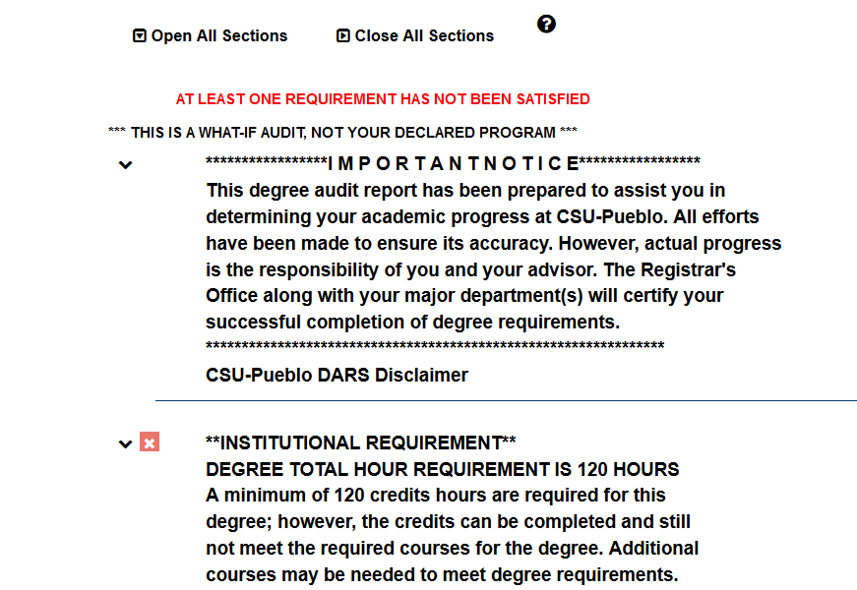
Use this button to navigate back to the previous screen to select a different audit
This shows the “what if” program for the student
Indicates this audit cannot be used for any official purposes

Slide 20
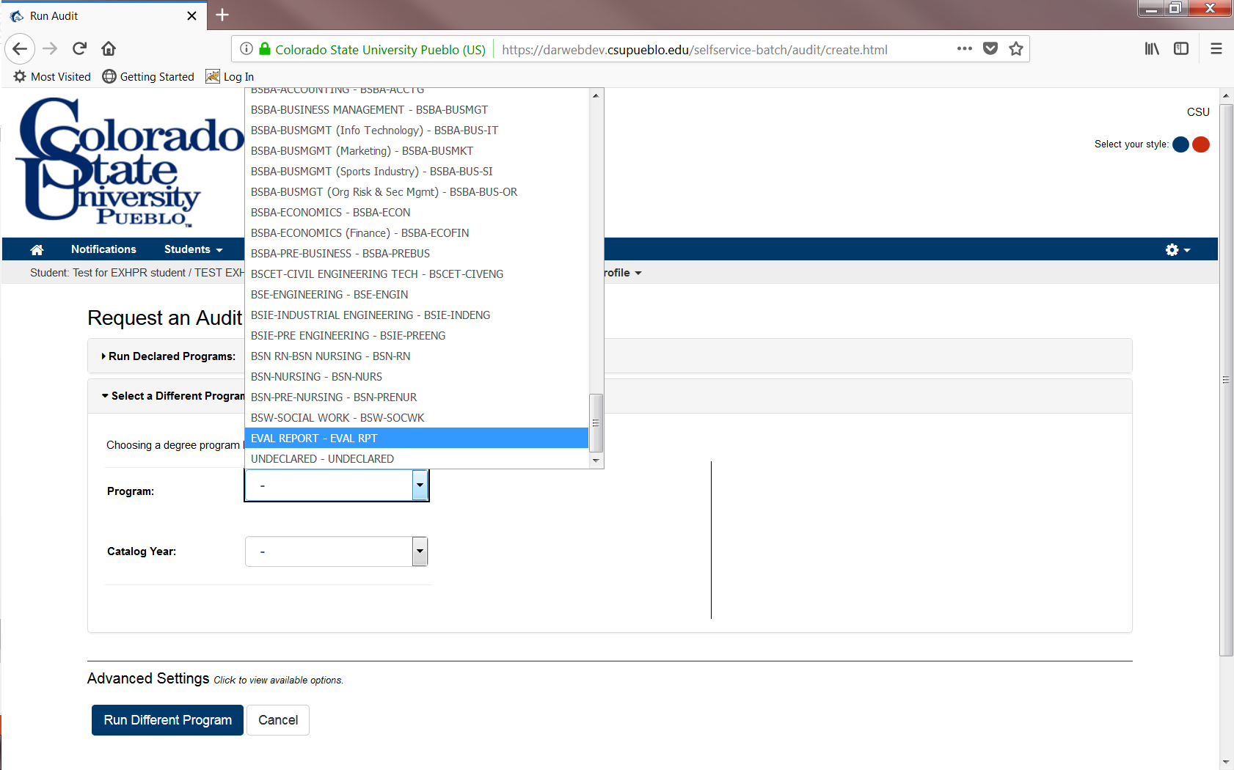
You can view an evaluation report for students with transfer work
Select their entry term
Select “run different program” to run evaluation report

Slide 21
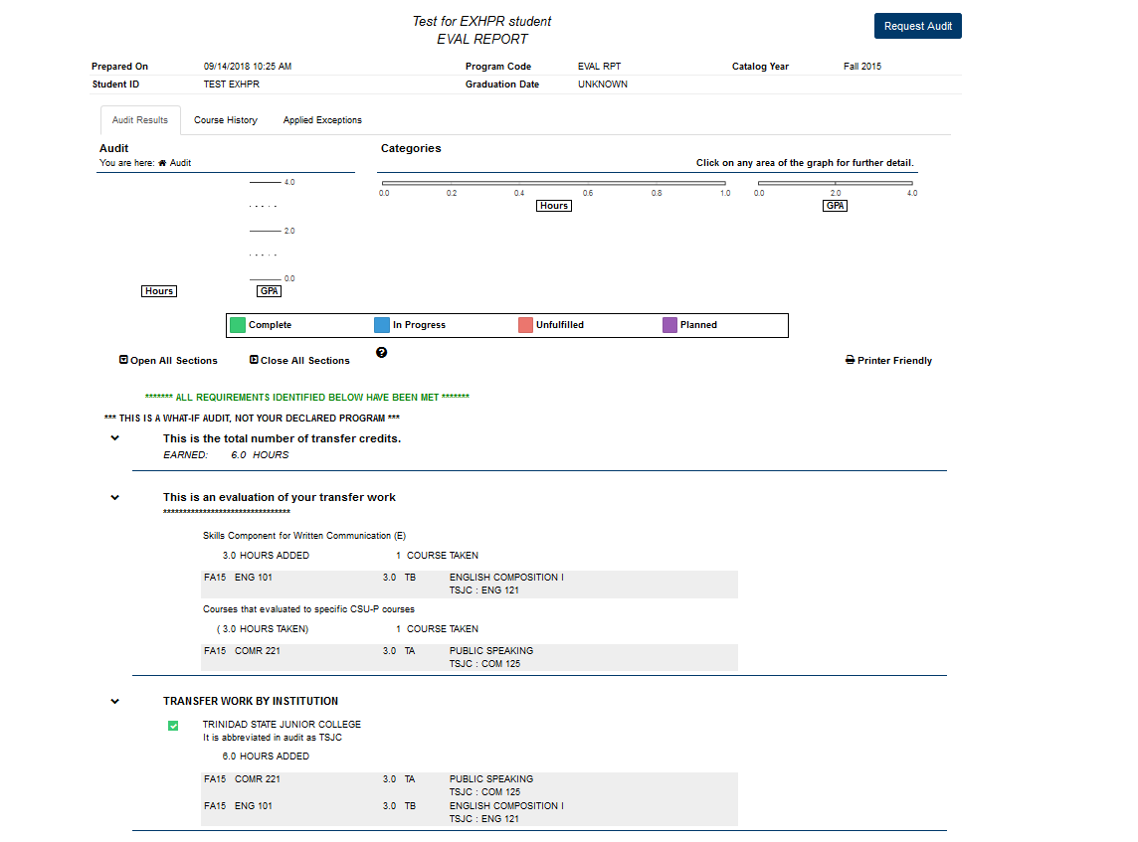
Indicates how many transfer credits a student is coming with

Slide 22
Let’s run an audit & evaluation

Slide 23
Quiz time
Does an “IP” count in a student’s course count?
Does an “IN” count in a student’s course count?
How do you make a transfer course count as a home course in the major?

Slide 24


Transfer questions
Transferology is a tool for students to review how courses might transfer to CSU-Pueblo or to find a replacement course at another institution for their degree.
Transferology lab is a tool for faculty and staff to see how a students courses might transfer, recruit students or help them find a replacement course at another institution.

Slide 25

TES: Transfer Evaluation System
The transfer evaluation system from Collegesource, is the premier interactive resource for course data from institutions of higher education.
TES empowers users to quickly locate course descriptions and employ powerful algorithms to generate lists of likely equivalencies between institutions.

Slide 26
Questions or comments?

Slide 27
Please fill out survey and return to presenter
Thank you for your time

