Slide 1
Like southwest, but on a plane filled with friends
Please sit with colleagues from similar functional areas

Slide 2
Academic advising
Planning for Success
Student
Faculty
Institution
Daniel A. Brown, Ph.D.
Dean | Director | Principal Investigator

Slide 3
Today’s conversation
Exploring roles and expectations for academic advising
Reflecting on demands on the advising ecosystem
Describing our advisees
Planning to meet their hierarchy of needs
What information will be helpful as CSU-Pueblo develops an “intentional and inescapable” plan for academic advising?

Slide 4
Our academic advising experiences in college
For the next 8-10 minutes, let’s think back to our college experiences
What resources were most valuable as you progressed toward the baccalaureate degree?
Who was your “advisor”?
Did you receive information that would have helped you succeed?
What information (if any) was not made available?
Individual reflection (2-3 minutes), shared conversation (5 minutes), report out to the group

Slide 5
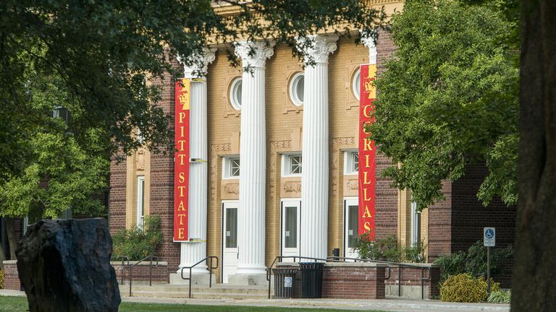
My experience | graduation by tri-fold brochure

Slide 6
yesterday’s Advising Ecosystem
Class Schedule
Advisor
Diploma
Student
Faculty

Slide 7
Today’s Advising Ecosystem
Class Schedule
Advisor
Diploma
Registrar
Title IV Aid
Peers
Student
Family
VA Benefits
Info Tech
Faculty
NCAA
Study Abroad

Slide 8
Today’s advising ecosystem
University
System
State Agency
Federal Department
Accreditor

Slide 9
Who are our students? How have they changed?
When we were in college | Today’s college student
12.2 million nationally (1985) | 22.5 million nationally (2019)
52.5% female | 58.2% female
Overwhelmingly white | Ethnically heterogeneous
Middle-to-upper income predominated | All income levels represented
Relatively inexpensive for publics | Increasingly expensive
Many first-generation students | Many first-generation students

Slide 10
A major shift | student loan debt
 | Student loans in 2019: A snapshot
$1.41 trillion | Amount of student loan debt outstanding in the USA
54% | Percent of college attendees taking on debt, including student loans, to pay for their education
$35,359 | Average amount of student loan debt per borrower
14.4% | Percent of adults with a student loan
10.8% | Amount of student loan debt that is at least 90 days past due or in default
$1.06 trillion in student loan debt only five years ago!

Slide 11
Articulating and planning for academic advising success
Developing mission / vision statements and goals
Developing policy and priorities
  See Texas State University Undergraduate Academic Advising Policies
Defining the ecosystem
Develop a marketing and communications strategy regarding academic advising
Benchmark advising services through authentic assessment

Slide 12
Today’s CSU-Pueblo Students | what do they need?
For the next 8-10 minutes, let’s think about what CSU-Pueblo students need from academic advising
Based upon these needs, who is in the CSU-Pueblo ecosystem?
  Who is not currently at the table with respect to your advising ecosystem?
Individual reflection (2-3 minutes), shared conversation (5 minutes), report out to the group

Slide 13
After counting heads, you can move to a new seat
Please sit with colleagues from similar families of disciplines

Slide 14
Developing an advising framework based upon student needs
Faculty Advisors
Hybrid Model
Professional Advisors

Slide 15
Model considerations | faculty as advisors
Strengths
  Direct link to the curriculum | content experts
  Opportunities to learn about career and graduation education opportunities
  Academic engagement
Concerns
  Increasing compliance expectations
  Continuing professional development
  Value within tenure and promotion system

Slide 16
Model considerations | Professional academic advisors
Strengths
  Advisor assignments and availabilities can be clearly articulated to students
  Clear expectations for performance as academic advisors
  Simplifies professional development and communication across the curriculum
Concerns
  Professional advisors lack deep knowledge of discipline
  Professional academic advisors are discipline agnostic
  Easy to overwhelm advising staff with additional duties

Slide 17
Model considerations | a hybrid model
Strengths
  Expands the number of available advisors for students
  Provides some flexibility and synergy with specific programs
  An option during times of transition
Concerns
  Less clarity for the advisee
  May lead to challenges with respect to responsibility and authority
  Professional development may be challenging
  Should be part of a plan and not a destination

Slide 18
Assessing quality of academic advising is key
How are you assessing the quality of academic advising at CSU-Pueblo?
  Direct measures? (Knowledge / skill acquisition)
  Indirect measures? (Nationally-normed surveys)
Formative versus summative assessment is key to program improvement
How will you measure change in the academic advising ecosystem?
Awareness of advising reputation and advisor ‘whole employee life’ is crucial

Slide 19
What have I left out? Questions?
As our workshop concludes, let’s reflect on CSU-Pueblo faculty and staff questions about academic advising on campus
What questions do you have?
What information do you need?
Individual reflection (1 minute), shared conversation (2-3 minutes), report out to the group

Slide 20
We’ve reached our destination!
Dr. Dann Brown
512-245-3579
dannbrown@txstate.edu

