Slide 1

How to Attract Adult Learners to Your Programs
Presenters:
Beth Doyle, CAEL
Tracy Costello, National Louis University
Joseph Levy, National Louis University
Lisa Myers, Texas A&M University, Texarkana
Notes:
Elizabeth Warner

Slide 2
The Hidden Higher Education Market
Many more adults than high school grads
Source for High School Graduates: National Center for Education Statistics. 2012-2013 school year. https://nces.ed.gov/programs/projections/projections2021/tables.asp
Source for Adults with some college and no degree: National Student Clearinghouse. https://nscresearchcenter.org/some-college-no-degree-2019/
Notes:
Beth

Slide 3
How to Increase Degree Attainment
In Lumina’s strategic plan, they recognize the majority of the gains will need to happen among adult students.
Notes:
Beth

Slide 4

How to Increase Degree Attainment
Strada’s target populations also emphasize adults:
6 million disengaged youth ages 16-24 not in school, work or training
10 million low-income college students from the bottom half of household income
44 million adults in lowest quartile for education and income
Notes:
Beth

Slide 5


Where most colleges market
Notes:
Beth

Slide 6

Can We Make the Shift?
To enroll more adult students
To give more people access to education
Notes:
Beth

Slide 7

Barriers
Multiple campuses
Faculty/Staff turnover
Resource constraints
  Lack of/limited budget
  Lack of staff to dedicate energy to marketing
Marketing materials not always provided in engaging format
  Pushing a one-size-fits-all effort to ineffective results
  Losing or missing audience’s interest/attention
Notes:
Tracy and Joe

Slide 8

Barriers
Introduction & overview
  Degree completion program
  PLA = Portfolio of transferable/marketable skills
Resource constraints
  From lack of to limited budget
  Program-dedicated marketing staff
One size fits all marketing
  Generic to specific
  Identifiable pain points
Notes:
Lisa

Slide 9
College Student Personas
Notes:
Beth

Slide 10
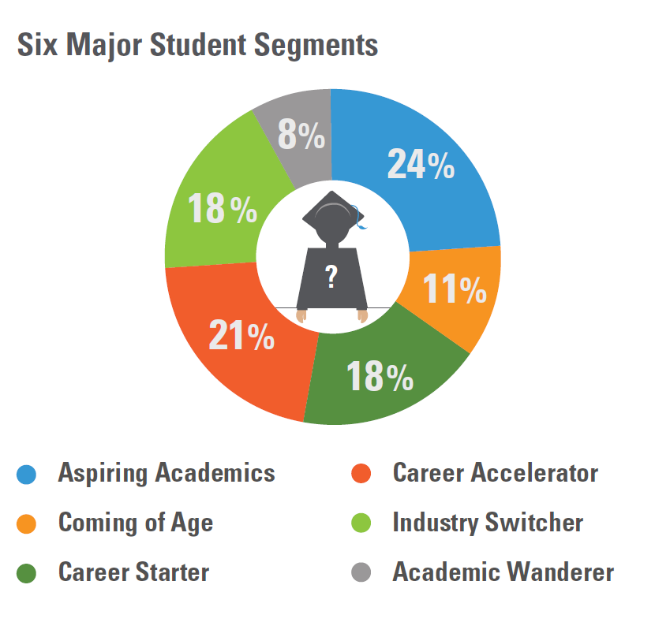
Thinking About Personas
Source: The Parthenon Group, “The Differentiated University
Notes:
Beth

Slide 11
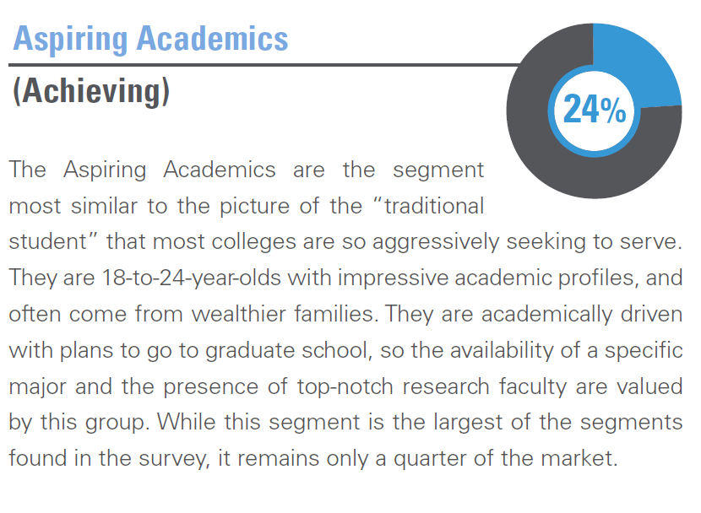
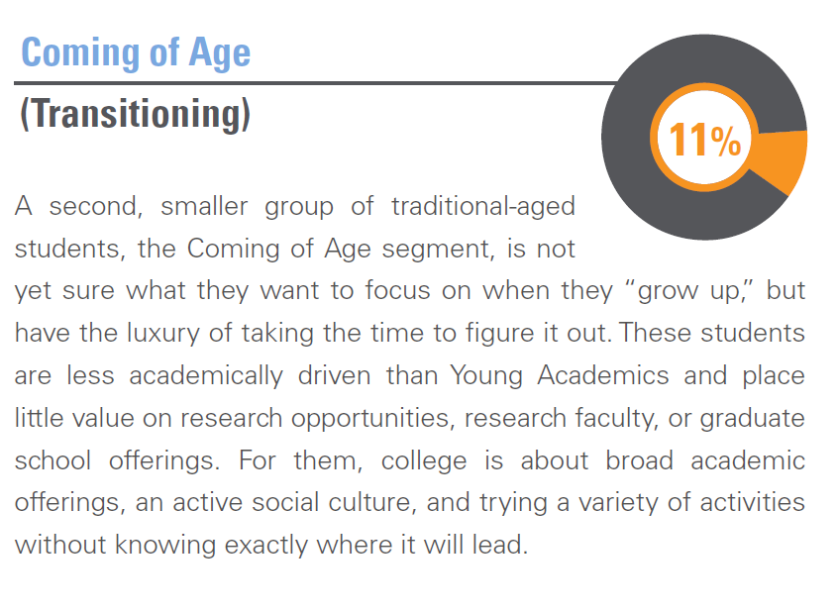
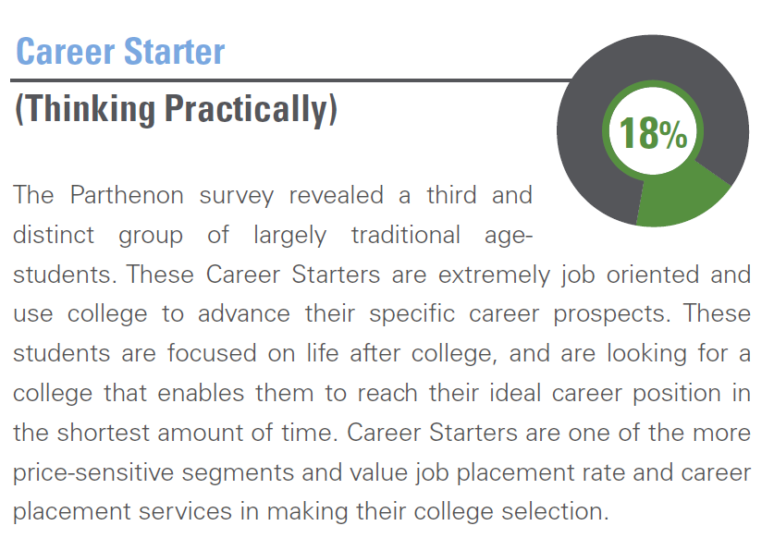
Thinking About Personas
Personas most colleges are targeting.
Source: The Parthenon Group, “The Differentiated University
Notes:
Beth

Slide 12
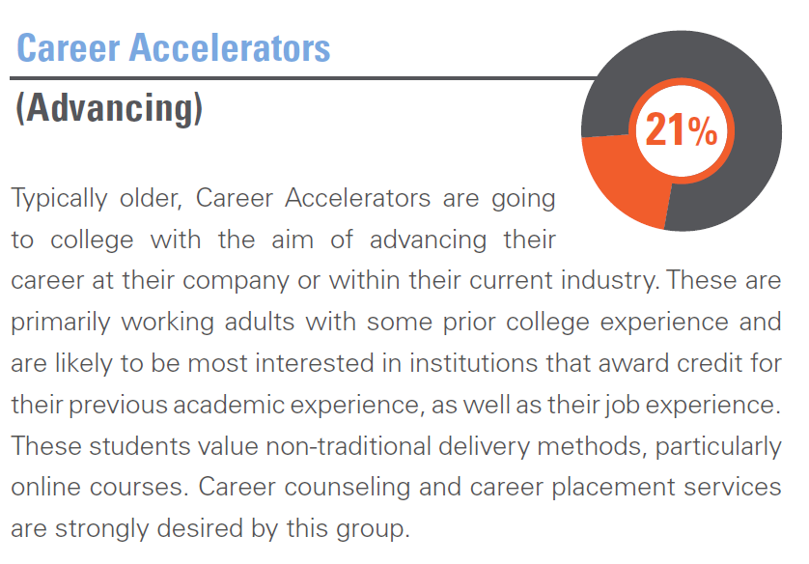
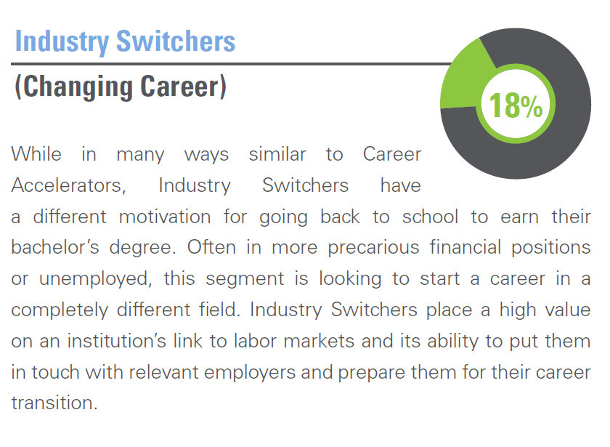
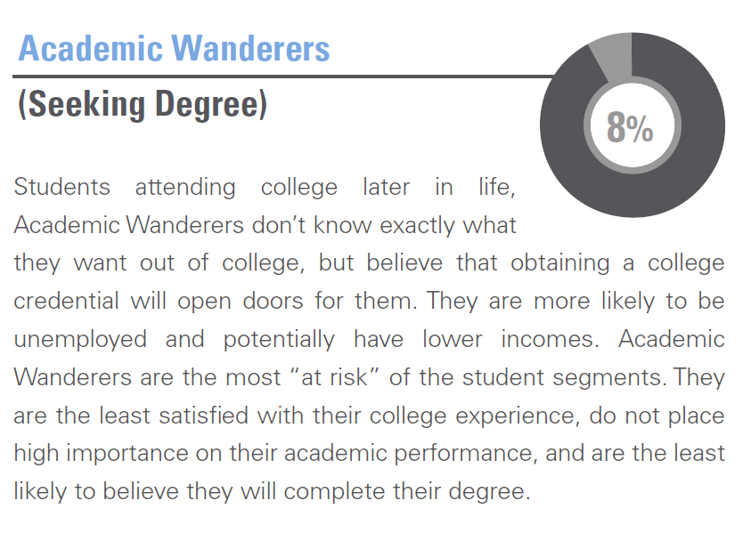
Thinking About Personas
Personas for most adult learners.
Source: The Parthenon Group, “The Differentiated University
Notes:
Beth

Slide 13
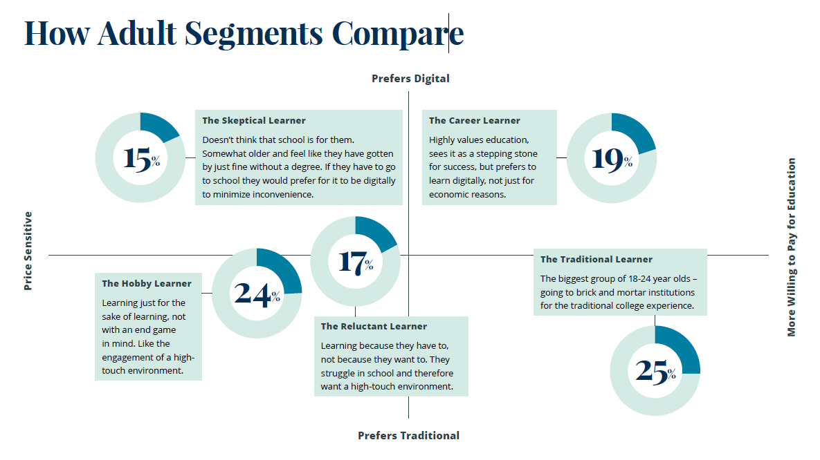
Another View of Personas
Source: The Future Learners by Jeff Selingo. Retrieved from: https://jeffselingo.com/wp-content/uploads/2019/07/Research-Future_Learners_Report.pdf
Notes:
Beth

Slide 14
Poll
Which persona best fits the majority of your adult students?
Notes:
Beth

Slide 15
Example: Career Accelerator
MS Human Resource and Development
MS Industrial and Organization Psychology
EDL – Educational Leadership
  Educational Leadership, Ed.D.
  Higher Education Leadership, Ed.D.
BS Management
Notes:
Tracy: This group of students needs a more direct marketing approach. Quick, to the point, and info about what they can gain from PLA, i.e., Program info sheets, centralized details on the website, use of data/meeting with faculty/programs, customized emails

Slide 16

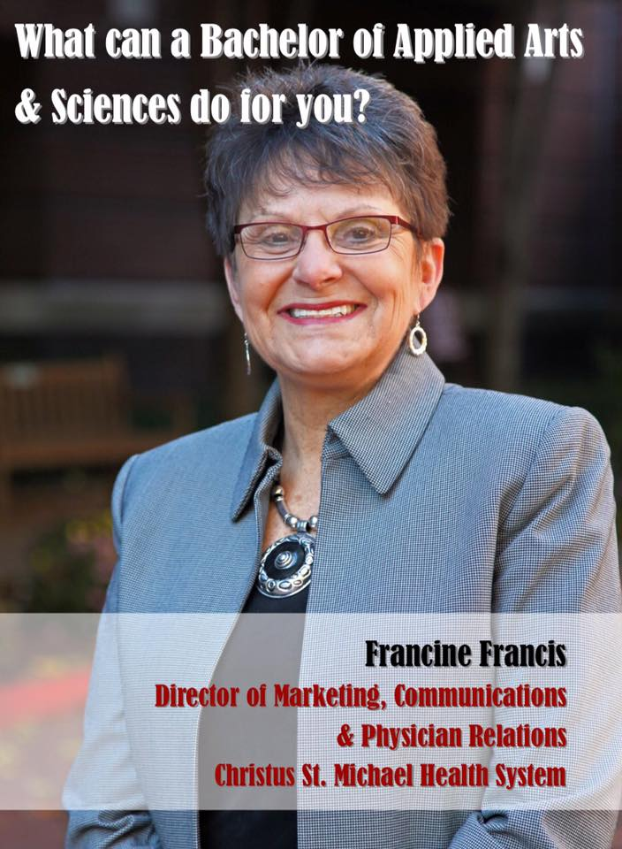
Example: Career Accelerator
Passed over (self-worth)
Motivated
Notes:
Lisa

Slide 17
Example: Industry Switcher
BA Applied Behavioral Science
BA Communications
BS Management
BS Health Care Leadership
BS Human Services
Notes:
Tracy: This group of students, Industry Switchers, benefits from the direct PLA marketing such as program info sheets, and centralized details on the website, but they also need more direct and personal marketing, i.e., class visits, program specific emails, flyers, PLA video (general information to energize students about PLA). In addition, use of PLA data when meeting with faculty/programs has been helpful in reaching these students via faculty support.

Slide 18
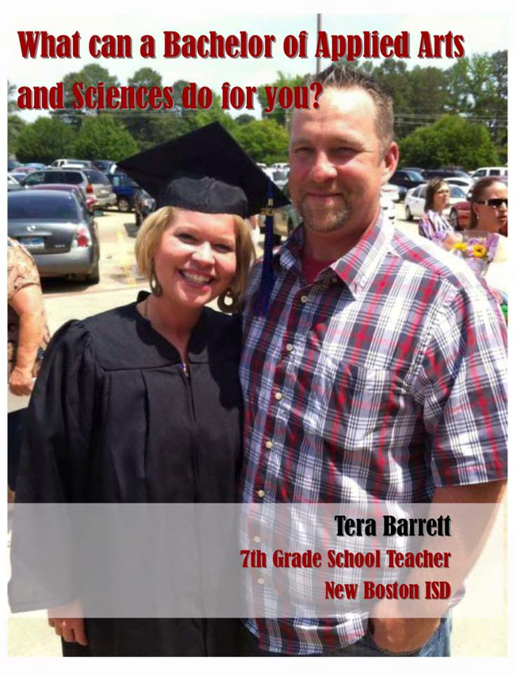
Example: Industry Switcher
Teachers
Professional AAS to BAAS
Notes:
Lisa

Slide 19
Example: Academic Wanderers
Attracting students to disciplines
Acknowledging learning/experience as credit to help cement interest
Notes:
Joe: These students benefit from the dual purpose of PLA marketing efforts. While some of the previous personas may be looking for specific information, the academic wanderer can benefit from the breadth of information and options available to recognize their prior learning or experience as credit and advancement down a pathway which could cement their interest.

Slide 20

Example: Academic Wanderers
Older / Retired or Unemployed
Personal goal
Notes:
Lisa

Slide 21

Ideas and Solutions
Improved marketing aesthetics
Customize marketing messages and materials for specific audiences
  Created program specific marketing pieces to be shared with students and faculty
  Customized emails per student programs
  Created roadshow information for college and department meetings
Centralized PLA details on the website
Introduced new media (video)
Use of data/statistics
  Emails and announcement
  Faculty/Program meetings
  Class visits
Notes:
Tracy and Joe: Added customized emails per student programs. We can expand on these marketing/outreach ideas/solutions by demonstrating how they have impacted the different student groups (personas).

Slide 22

Targeting the Market
How Do We Choose Who to Target?
  Location
  College Mission
  Good fit for PLA
  Industry Sectors
Notes:
Beth

Slide 23

Establishing a Niche
What do we do better than them?
What do we have that they don’t?
Now put that in the context of what adults are looking for.
Notes:
Beth

Slide 24

Outcomes
Increase to present at meetings
Increase in student program participation
Increase in responses to program specific emails
Increase in the development/implementation of new CPL programs
Increase in faculty “buzz” about PLA
Increase in faculty, staff, and administrators thinking of PLA as a solution or partner for collaboration or innovative academic opportunities
Invitation to present and write about practices for external entities
Notes:
Tracy and Joe

Slide 25

Outcomes
Increased enrollment/persistence
Increased program recognition
Increased diversity
Increased perceived value
  University
  Students
Notes:
Lisa

Slide 26
Future
Continue to review data to analyze areas of growth, as well as areas needing attention
Sharing results through information campaigns about services and improvements
Continue to improve upon marketing/outreach processes to provide equity and transparency
Leverage an expanded advisory board to include more institutional perspectives – which both informs PLA practices and helps spread PLA information more broadly
Notes:
Tracy and Joe

Slide 27
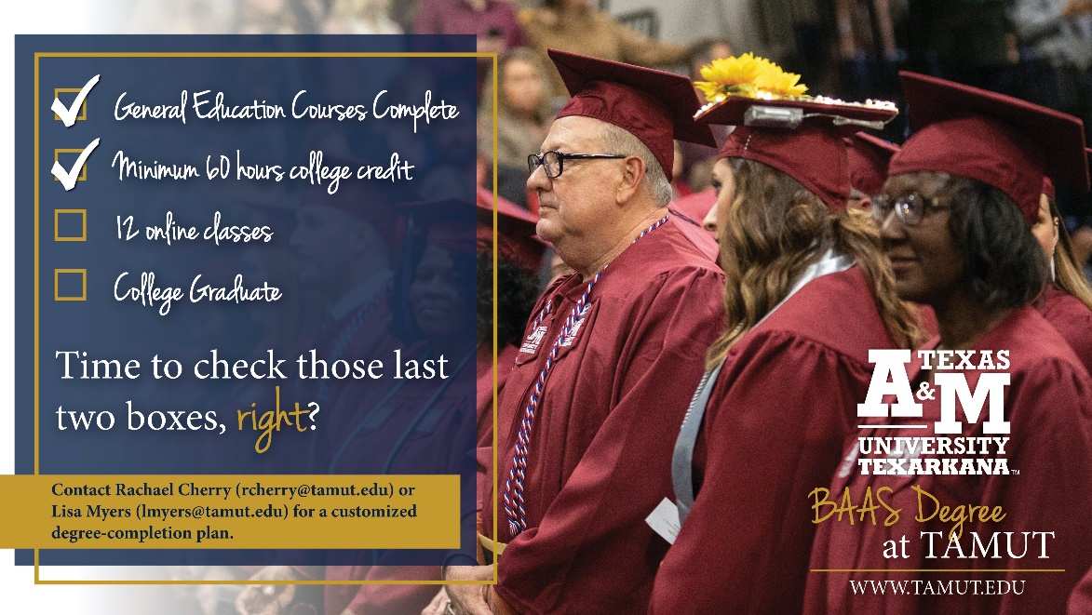
Future
Target audience
  Personas
  Pain points
Incorporate marketing survey (Intro course)
Increase graduate voices
Increase 60x30Texas & community college partnerships
Notes:
Lisa

Slide 28

Start Identifying the Audience
Target
Pain Points
Messages
Notes:
Beth

Slide 29
Q&A
Notes:
Elizabeth Warner

