Slide 1
Sociology
Colleen Hackett, PhD
I am including a write-up on the ways in which the Inside Out Prison-Exchange program has had an impact on students, along with photos, final projects, and a link for a video on the program.
The Inside Out Prison-Exchange program offers meaningful and transformative learning opportunities for CSU-Pueblo students, specifically those desiring a more intimate understanding of the criminal justice system. Each week a group of college students travels to a women's prison, just 5 miles away from the university, to join an equal number of incarcerated students and to learn about some aspect of the prison system. We academically engage with criminological concepts, while also learning about our own relationships to mass incarceration and connecting with others in more humanistic ways, no matter what side of the prison wall they reside in. This course has offered incarcerated students exposure to higher education and college-level material. Additionally, Inside-Out has provided tangible experiences for CSU-P students that are better defining their future educational and career goals. I have included two statements from students, one incarcerated and the other non-incarcerated, to demonstrate the impact of this unique educational experience:
"I am encouraged to meet several young people with enthusiasm and creative ideas for criminal justice issues and compassion for offenders. It’s easy to imagine that we are forgotten and deemed worthless. They reflect hope. This program is mutually beneficial to break down biases or ignorance about either group." - Claire, incarcerated student
"The biggest take-away from Inside-Out has been just how much it means to see advocacy coming from somewhere you least expect. Whether it’s inside to outside students or vise versa. Telling someone 'I’m here for you, I believe you, and I’m rooting for you' means so much more in an environment like this. Inside-Out has given me a view of myself that I’ve never had. It has boosted my confidence, self-worth, and it was changed my willingness to forgive myself and grow. Inside-Out has changed everything about how I see others. I’ve noticed I’m less likely to attach an 'us vs them' scenario to everything in life and see people as people not their mistakes. I have noticed though that I’m more likely to speak up when I see someone abusing authority or purposely talking down to someone. Inside-Out has initiated dialogue among differences and has in fact made us all realize we are more similar than we ever imagined. Inside students are able to see that there are people outside of DOC that are rooting for them and it is important for outside students to put faces and emotions to the people we learn about everyday." - Maria, CSU-P student

Slide 2
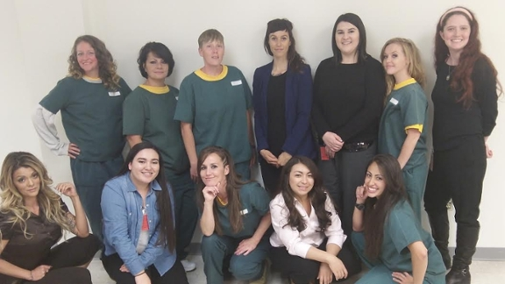
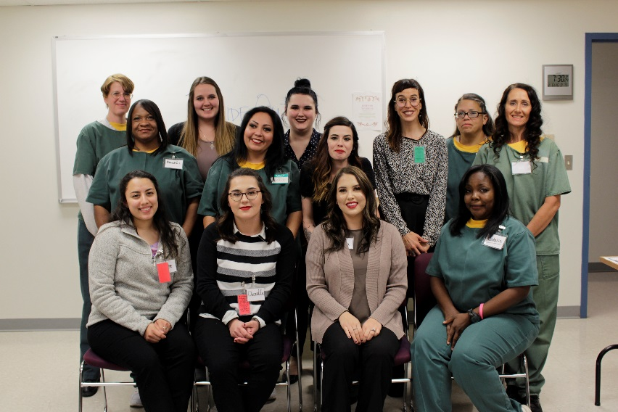
On the CSU-P Inside Out website, you can find a video with personal testimonies and scenes from the graduation for the inaugural class of the Fall semester of 2017: https://www.csupueblo.edu/sociology/inside-out-prison-exchange-program.html
I have also included graduation photos and final project pamphlets. So far, each Inside-Out class has desired to create a textual archive of their final research projects that both incarcerated students and CSU-P students can keep long after the class is over. Moreover, these pamphlets are distributed within the women's prison and to correctional staff in an effort to help change cultural norms and institutional policies. The first pamphlet explores the benefits of gender-responsive therapies and the second pamphlet connects students' oral histories with each other and with a general timeline of mass incarceration.
Professor Schlosser received a Library grant and funds from the CHASS Center on Social and Economic Justice to support Dr. Schoen's visit to campus. The Sociology department and Women's Studies program also provided funds for the event. Dr. Schoen's talk was attended by between 30-40 people (students, faculty and staff) and it went extremely well. I was impressed by the questions many students asked following her presentation.

Slide 3
History
Matt Harris, Professor of History, organized a panel with a student and presented at the John Whitmer Historical Association Conference in Sept in Kansas City. In October, his article entitled "The Mormon Church and Lineage: The Complicated History of African Americans and Patriarchal Blessings, 1830-2018" was published in Dialogue: A Journal of Mormon Thought. In August, he presented a version of this article at the Sunstone Conference, on the campus of the University of Utah.
Jonathan Rees, Professor in History. The student projects linked here are based on hands-on experience in local archives:
http://scalar.usc.edu/works/colorado-history/links-to-old-projects
Many have led to internships. Some have led to actual paying jobs.

Slide 4
Mass Communications
Samuel Ebersole, PhD
$7K from Rawlings Foundation to fund continued video/web production to highlight the importance and value of water in the Arkansas River basin in Colorado.

Slide 5
Anthropology
Bruce Lutz – Impactful Experiences for Students
Developed an Anthropology internship program which, thus far, has introduced students to the world of archaeology and museum studies. Specifics of the internship program are:
Students have excavated archaeological sites in Colorado with the Office of the State Archaeologist and other professional archaeological organizations. This gave students hands-on experience showing how proper excavation techniques and recording lead to meaningful analysis.
One student worked with the State Archaeologist on analyzing historical archaeological materials. This student gained knowledge of different analytical methods.
Students have interned in the El Pueblo Museum and the Smithsonian Institution. Because of this one student will be on the staff of the Heritage Museum and the other student will be going on graduate school in museum studies.
As the Faculty Advisor to the Indigenous Student Association I have introduced students to indigenous peoples. These students have not only had lengthy conversations with indigenous peoples but have also participated in indigenous ceremonies. Because of this have not only seen but have learned to appreciate another view of the world.
Gave a joint lecture on Neanderthals with Dr. Kathy Friel. This viewed Neanderthals from the perspective of Psychology and Anthropology. It gave students the opportunity to see analyses from different perspectives. The joint lecture was very well received by students.
Though it cannot be put into a specific context, in all my courses I emphasize analysis. Education in my view is not only knowing facts but the ability to evaluate which series of facts make the most sense as they pertain to a set of problems.

Slide 6
When I began my college career, I had never imagined that I would have chosen to pursue my studies in anthropology but I am extremely grateful that I did, especially at CSU-Pueblo. I have been presented with a number of experiences and opportunities such as internships, executive roles, have been able to meet and collaborate with various cultural members within the community.
The anthropology department has provided me with the resources to become an intern at the El Pueblo History Museum where I volunteered with the education department and helped facilitate and create informative, cultural, and interactive activities. I have also been able to inform myself about the cultural history in the surrounding areas, contribute to moving and permanent exhibits, and have gained experience with children by teaching them using unique, hands-on methods.
I have also been granted one of the most amazing experiences of a life time and I was able to intern at the Smithsonian’s National Portrait Gallery for a ten week period during the summer. There I, too, worked in the education department and was able to be more involved in the creative and educational process, which included creating lesson plans and even conducting research online, within the museum system database, and official curatorial files for specific events and famous peoples, such as Frida Khalo. Additionally, I worked with people of various ethnicities, races, sexualities, and so forth, within our events and programs. For instance, we had events in support of LGBTQ+ members, we also had a program called Conversation Circle where people, whose primary language wasn’t English, would come every Friday morning and we’d talk about some of the portraits in order for them to enhance their English speaking abilities.
On top of that, I had gained experience just from being in Washington D.C. Being on the other side of the country was a culture shock in itself, but being able to witness and partake in the rallies and political parades was something else, especially because we were in the most political place in the nation. I gained a whole other understanding of the people and I was able to feel the passion, but I only could have ever done it by fully submerging myself in the culture, like a good anthropologist does.
Then last but not least, from being involved with the anthropology department, I have also been lucky enough to obtain the executive role of President in one of the department clubs, the Indigenous Student Association. Not only have I gained organizational experience, such as event planning and marketing, but I have also been able to collaborate with community members of Indigenous heritage. These members have taught me more about cultural traditions and ceremonies than I could have ever learned in a classroom setting. Their contribution to our organization has also inspired me to continue studying Native American history and culture as I move further in higher education.
Overall, these opportunities would have never been presented to me, had I not been in the anthropology department. Pursuing a minor in anthropology has expanded my view of the world and has broadened my college experience.

Slide 7
English
Dr. Doug Eskew’s essay, ”White Trash Pantego” was published in Inventing Place: Writing Lone Star Rhetorics, ed. Jenny Rice and Casey Boyle. Southern Illinois UP. 2018.
Dr. Madison Furrh’s essay, “Tale of the Comet: Enlightenment Discourse, the Salem Witchcraft Trials, and the Undoing of Puritan Orthodoxy” has been published in the book New Approaches to Religion and the Enlightenment.
Professor Juan Morales published poems in Copper Nickel, Verse Daily, and a poem was featured on Colorado Public Radio. He also had featured readings at Colorado College, Pueblo Community College, the Castle Rock Writers Conference, Lighthouse Writers in Denver, Denver’s BookBar, Red Planet Comics in Albuquerque, NM, and a release reading in Pueblo in support of his new poetry collection, The Handyman’s Guide to End Times (University of New Mexico Press, September 2018). He also visited creative writing classes via Skype at Oklahoma State University, Clemson University, and San Francisco State University.

Slide 8
Pilgrimage, a national literary magazine that has been in circulation for over 42 years. Pilgrimage is published twice a year and allows faculty and two student Editorial Assistants to gain valuable publishing, marketing, and design experience. For more information, visit www.pilgrimagepress.org. Professor Juan Morales is the Editor and Publisher of Pilgrimage.
Modern Day Conversation Salon for Homecoming week-This was a Homecoming event that allowed COMR to partner with the Alumni Association to bring together faculty, students, staff, and community members for small group discussions on current issues.
Creating Talk & Texts in partnership with El Centro del Quinto Sol (a local community center): CSU-Pueblo COMR seminar students developed workshops related to their major/minor areas of study, presented these workshops to students aged 4-17 twice per week, helped one another with their workshops, and worked with program coordinator, students, and counselors to develop programming.
Steelworks Museum of the West Partnership--archival research under direction of Dr. Madison Furrh, which was presented at the CSU-Pueblo library.
Tempered Steel, CSU-Pueblo’s student literary magazine publishes an annual issue every spring that features student creative writing and is edited, designed, and produced by students enrolled in the class. Students study literary magazines, interview with leading literary magazines in the United States (including Crazyhorse, Copper Nickel, and Sugar House Review).

Slide 9
Psychology
Krista D. Bridgmon, Ph.D., NCC
Three classroom exercises that are currently in press. They are going in an e-book for innovative college teaching. I have the press final drafts if the provost would like.
Bridgmon, K. & List, E. (In Press, 2018). Empathy using labels: Classroom diversity activity.
In R. L. Miller (Ed.) Teaching Tips: A Compendium of Conference Presentations on Teaching, 2017-18. Retrieved from the Society for the Teaching of Psychology web site: http://teachpsych.org/ebooks/
*Bridgmon, K. & Frick, C. (In Press, 2018). Classroom exercise for examining emotional vocabulary. In R. L. Miller (Ed.) Teaching Tips: A Compendium of Conference Presentations on Teaching, 2017-18. Retrieved from the Society for the Teaching of Psychology web site: http://teachpsych.org/ebooks/
*Bridgmon, K., Knabe, R., Murphy, K., & Schroeder, R. (In Press, 2018). The symbolic puzzle of teaching intake interviewing. In R. L. Miller (Ed.) Teaching Tips: A Compendium of Conference Presentations on Teaching, 2017-18. Retrieved from the Society for the Teaching of Psychology web site: http://teachpsych.org/ebooks/

Slide 10
Music
In October 2018, the CSU-Pueblo Prometheus Piano Trio (Dr. Zahari Metchkov, piano; Dr. Timothy Hsu, violin; Norah Clydedale, cello) performed on the campus of the University of Virginia's College at Wise as part of the Pro-Art concert series in Wise. Dr. David Volk, piano, and Norah Clydesdale, celllo, performed an additional concert on the series as well, featuring three sonatas for cello written by Dr. Volk.

Slide 11
Social Work
Mario Rodriguez presented at the Latino Social Workers Organization Conference in Chicago Illinois on October 18, 2018. The topic was Health Aging and the Latino Family: The Latino Paradox.
Mario Rodriguez was appointment by Governor Hickenlooper to serve on the Social Work Board of Examiners for the Division of Regulatory Agencies.
The Department of Social Work is working with CSU-Ft. Collins to bring the Campus Connections mentoring project to CSU-Pueblo. The program will utilize university students to provide mentoring for at-risk youth in the Pueblo community. Dr. Pam Richmond is coordinating this program.

