Slide 1

THE PACK CENTER
APC – Winter 2020

Slide 2
What is it?
01
The history and mission of the CSU Pueblo PACK Center

Slide 3
1. Purpose
The PACK Center is the hub of the new advising and student support model at CSU Pueblo and is supported by the 2028 vision – it is a one-stop problem-solving shop for students to get connected with what they need both on-campus- and community-wide.
Mission:
  The PACK Center will support students throughout their entire academic career at CSU Pueblo.
  Professional Academic and Career Knowledge = PACK
The PACK Center is a collaborative effort between:
  Academic Advising services – previously done in the CAE and Academic Depts. (Hybrid –Centralized Model)
  Career Center services
  All student services (Housing, SEAL, International, Financial Aid, etc..)
  Testing Center and Tutoring services
  Academic Improvement Program

Slide 4


2. HISTORY
2007: First Year Programs is founded to support incoming freshman with academic advising
  Directed by Derek Lopez
2013 : The Center for Academic Enrichment is founded, combining:
    First Year Programs
    Student Academic Services
2019-2020:
  The PACK Center is conceived, approved, and
  will launch Spring 2021!
Notes:
COVID has Slowed many of these efforts

Slide 5
3. The Birth of the PACK CENTER
CSU Pueblo VISION!!
A collaborative committee composed of faculty, department chairs, advisors, Provost office, Career Center, and other university stakeholders was formed to review current advising at CSU Pueblo and map out the student experience from start to finish.
The GOAL:
  Increase matriculation, transfer, retention, and persistence rates at CSU-Pueblo
  Enhance the overall student experience and provide a service to the students, campus departments, and academic departments across campus
A series of gaps in the student academic experience were identified, and solutions were proposed
  A more holistic advising model: support beyond the first year
  More seamless handoff from admissions to CAE/PACK Center
  Greater and earlier integration of Career Center services
  Greater collaboration between academic departments and CAE
Notes:
Just to name a few. More gaps have been identified and are being worked on.

Slide 6
How DOES IT WORK?
02
How will the PACK Center improve the student experience at CSU Pueblo!

Slide 7
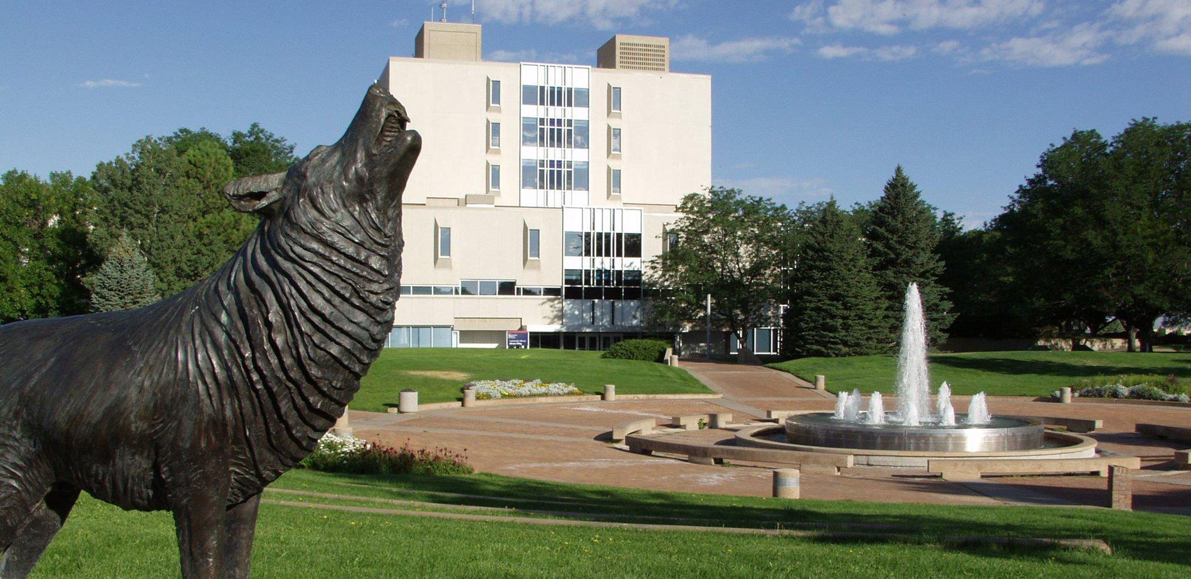
The student success network
Students will have an Academic Success Team working to support them from the day they step foot on-campus until their degree is conferred.
More connections = students feel more connected & develop a stronger sense of belonging.
Peer Mentors for student-perspective guidance in addition to academic success coaching
Connected with a variety of supportive CSUP programs

Slide 8
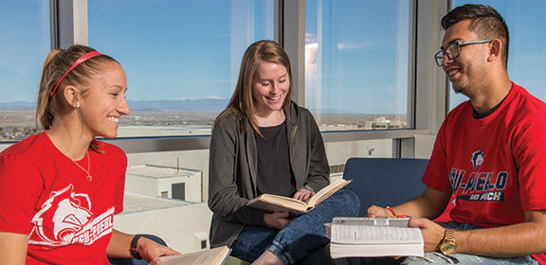
The student success network
The Academic Success Team players:
  Academic Success Coaches 1 (ASC 1)
    Located in the PACK Center
    Academically coach students with 0-60 credit hours earned
  Academic Success Coaches 2 (ASC 2)
    In PACK Center and satellite in Academic Depts.
    Academically coach students with 60-120+ credits earned
  Faculty Mentors
    Major department faculty members who work with students from start to finish
  Peer Mentors
    CSUP students offering peer-perspective support
The extended network:
Career Center
  Continuous support starting year one
  Community connection
  Handshake
Transfer Advisors
  Addressing Transfer-specific issues
COSI Advisor
  PHEFF and DSF scholars
Academic Improvement Plan
  Coming soon – Retention Specialist

Slide 9

Upcoming logistics
Enhanced collaboration with Admissions
The Writing Room moving to Library
Former Writing Room space > Testing Center
  DRO, Extended Studies, Accuplacer, National Testing, Academic Department testing, etc.
Disability Resource Office moving to Career Center
Career Center housed in PACK center to enhance career and Academic Success Coaching
The DEN – one-stop shop

Slide 10

DATA COLLECTION
Help increase conversion rates
Complete College America (15 hours/ 30 hours a year/ 4 year graduation)
Retention impact
Persistence to graduation
Academic Probation
Connection to career opportunities e.g. internships
Student surveys, exit interviews
SLO’s for first year and continuing students

Slide 11
WHY a pack center?
03
The big picture

Slide 12
Overall Goals
Enhance the student experience
Provide holistic support for every student who steps on campus
Improve inter-departmental collaboration across campus
Increase enrollment, retention, and persistence rates
Optimize transfer student processes and outreach to increase transfer population
Implement comprehensive support system for at-risk students
Address identified gaps and fix them
Collect data to make educated decisions regarding student success
Continue to push CSU Pueblo to be the People’s University of the Southwest #VISION2028

Slide 13
ThAnk you!
Questions?
  John Sandoval, Director CAE - committee co-chair
  Dr. Brian Vandenheuvel, Executive Director of Undergraduate Studies - committee co-chair
  Lee Saunders, Lead Transfer Advisor
  Michelle Gjerde, Director - Career Center
Visit our new webpage*
  www.csupueblo.edu/pack-center/index.html
  *Launching officially January 2021

